Slide 1
Denison 2022 Global Forum: Digital Transformation

Slide 2
Building a Digital Culture: Is Your Organization Ready?

Slide 3
Building a Digital Culture: Thoughts? Experiences?
What does Digital Transformation mean for you?
* Please add your name and organization in the chat when you join this Digital Transformation networking session.
Notes:
Key themes that we have heard about Digital Culture: -Understanding that people are the priority in a technological revolution -Creating intense interaction with a purpose! -Clarity about coordination needs and priorities

Slide 4
Digital Transformation
Digitalization represents a major challenge for many organizations. It requires a new way of thinking, a new way of leading, and a new way of doing business. We’ve researched this topic and have developed a model and set of measures to help our clients assess track their progress.
Our model has six components:
* Please add your name and organization in the chat if you have just joined this Digital Transformation networking session.

Slide 5
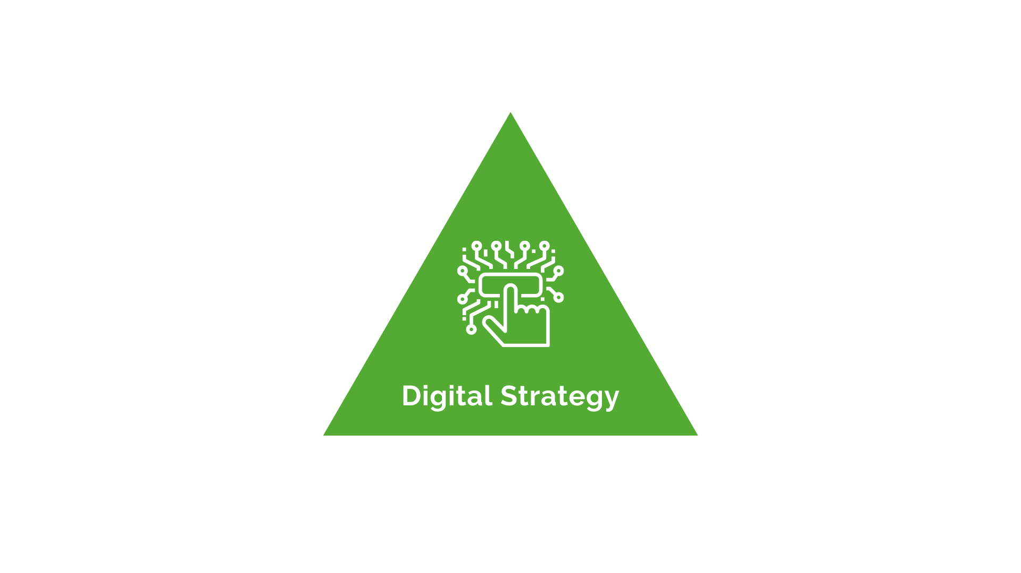
Digital Strategy
Guiding an organization through a digital transformation requires a clear strategic plan. Leadership need to be aligned, and the strategy should be widely communicated, well understood, and clearly visible in day-to-day decisions
Our leaders have clearly communicated our vision for our digital transformation
Our digital transformation strategy is visible in our day-to-day decisions
We have a comprehensive strategy to collect, process, and analyze data from all available information sources
* Please add your name and organization in the chat if you have just joined this Digital Transformation networking session.

Slide 6
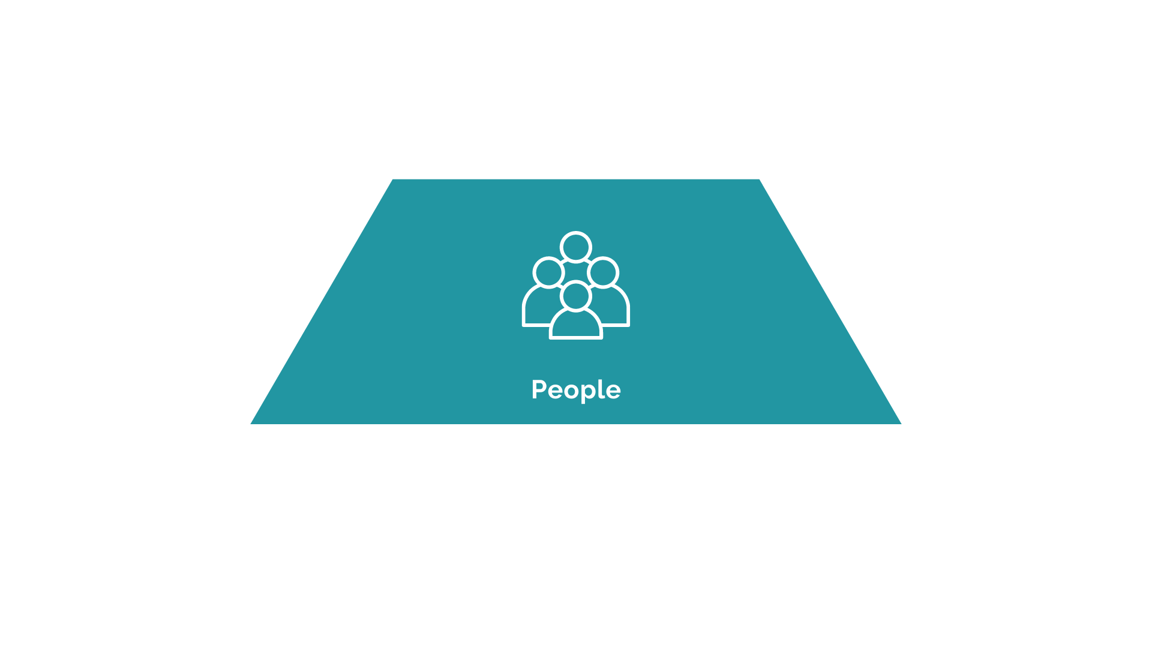
People
A change of this magnitude always requires a culture change. This always means that changes are required in people’s mindset, talent, and leadership skills. One key element of this transformation is building the deep digital talent – the data science, software development, and AI expertise required to succeed
4. Our digital talent creates a clear advantage over our competitors
5. We have the skills and capabilities necessary to implement our digital transformation
6. We are aggressively recruiting the digital talent that we need for the future
* Please add your name and organization in the chat if you have just joined this Digital Transformation networking session.

Slide 7
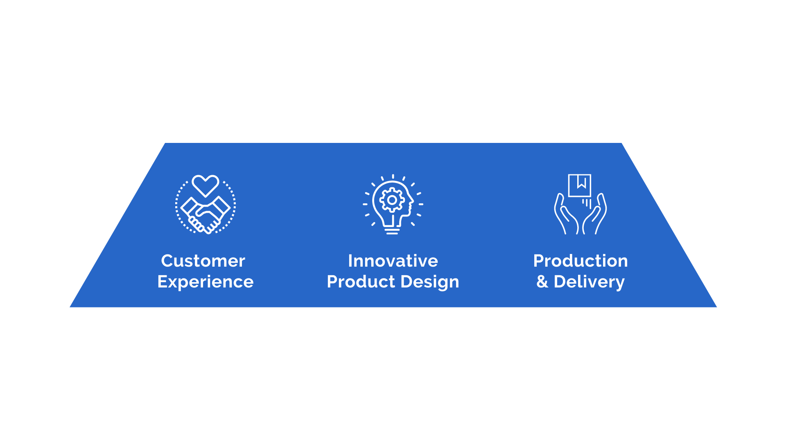
Customer Experience
The value chain in the digital world begins with the customer. The customer experience drives innovative product design and the production and delivery process. This whole process must be built around a real-time understanding of the customer experience
7. Our digital capabilities allow us to deliver easy, effective and emotional customer experiences
8. Our digital strategy allows us to better meet the needs of our customers
9. We are able to use real-time data and analytics to deliver a tailored customer experience
* Please add your name and organization in the chat if you have just joined this Digital Transformation networking session.

Slide 8
Innovative Product Design
Innovative products are designed and redesigned around customer needs. This process is informed by a continuous process of monitoring the customer experience through real-time analytics
10. Our new product design is informed by real-time data on the customer experience
11. We continuously monitor our products and customers to deliver more value
12. Our product design takes full advantage of our data and analytic capabilities
* Please add your name and organization in the chat if you have just joined this Digital Transformation networking session.

Slide 9
Production & Delivery
The process of producing and delivering products is also enhanced by a firm’s digital capabilities. The production system is enhanced by digital capabilities, and predictive analytics are used to anticipate customer support needs
13. Our digital capabilities allow us to have an agile production system
14. We use predictive analytics to help anticipate customer support needs
15. We use our digital capabilities to automate and streamline our production capabilities
* Please add your name and organization in the chat if you have just joined this Digital Transformation networking session.

Slide 10
Infrastructure
A company’s digital platform is the foundation for all of these innovations and is one of a company’s most important competitive assets.
16. Our digital infrastructure creates a solid platform to support all of our innovations
17. Our digital capabilities allow us to develop innovative new business models that help us compete
18. Business users have continuous access to up-to-date data and metrics that help us compete
* Please add your name and organization in the chat if you have just joined this Digital Transformation networking session.

Slide 11
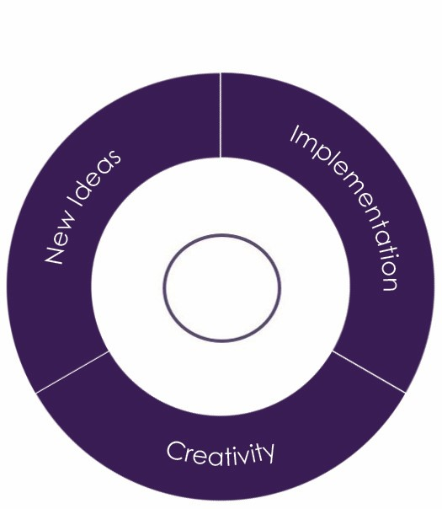
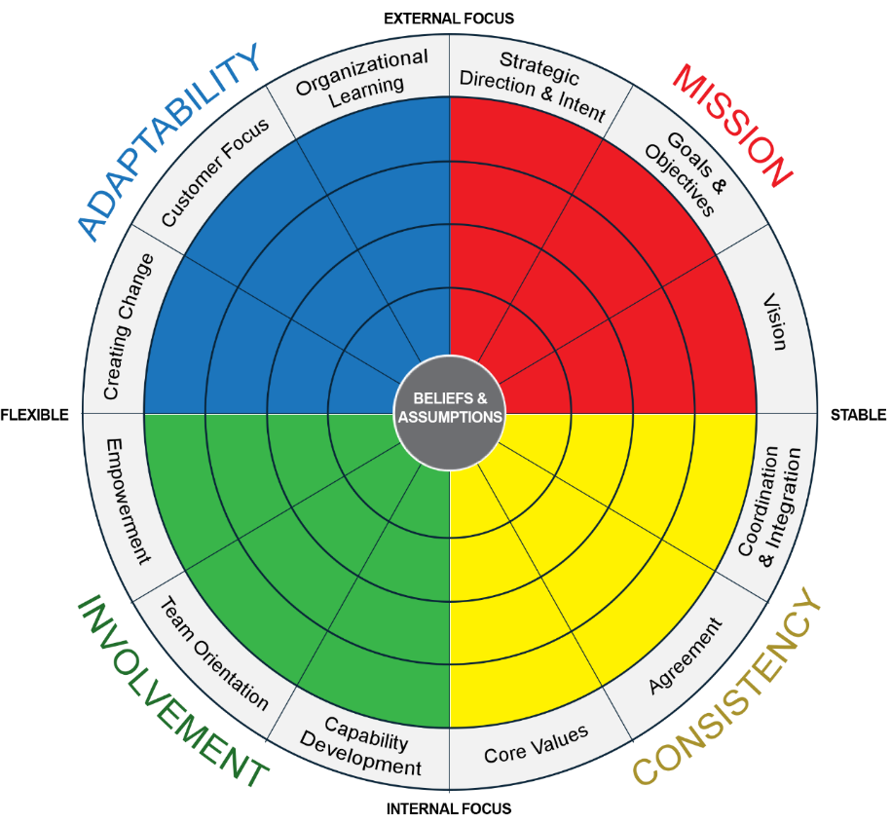
Digitalization and Denison’s Culture Model
Flexibility
Agile Response to Change
Continuous Improvement
Cross-functional Coordination
Cutting-edge Strategy
Organizational Alignment on Goals
INNOVATION
Encouraging Creativity
Ability to Implement New Ideas
Continuous Evaluation of New Ideas
Support for Developing New Ideas
Investment in Innovation
Information Sharing
Delegating Authority
Investing in People
Clear & Consistent Values
Accountability
Effective Problem-solving
Consistency in Processes & Structure

Slide 12
Building a Digital Culture: Thoughts? Experiences?
How does your organization define Digitization vs Digitalization vs Digital transformation?
How can you build “cultures” in a digital environment?
How would you describe digital transformation in your organization? What are the challenges? How have these challenges been addressed?
What are some of the challenges you face as a leader in this digital world? How have you overcome them, or what steps are you taking to overcome them?
What other changes are on the horizon, that are not being discussed?
* Please add your name and organization in the chat if you have just joined this Digital Transformation networking session.
Notes:
Key themes that we have heard about Digital Culture: -Understanding that people are the priority in a technological revolution -Creating intense interaction with a purpose! -Clarity about coordination needs and priorities

Slide 13
Illustrative Examples of Digitalization
The US government plans to leverage partnerships between employers and technology innovators to increase access to high-quality and personalized learning.
Airbus’ vision of applying innovative technologies to design and manufacturing, enabled them to use 3D-Printing to develop improved aircraft parts.
BMW is offering DriveNow, a car sharing service featuring BMWi electric cars to promote sustainable mobility.
Toys R Us likely banked on the assumption that all it had to do was launch an e-commerce store and that the customers would come in droves. What resulted was purely transactional customer experience not customer engagement.
Rio Tinto established an operations center - , more than 400 operators from one site can analyze data and synchronize an integrated system in real time, managing 15 mines, 31 pits, four port terminals and a 1,600km connecting rail network leading to increased efficiency, reliability and lower variability.
LEGO transformed by launching new digital based businesses such as movies, LEGO Mindstorms, video games and applications, connected to their block systems that are more appealing to digitally savvy customer groups.
Excerpts from:
World Economic Forum Digital Transformation Initiative
Forbes

