Slide 1
‘Executive Teams and Leadership Coaching’
A few tools and techniques to utilize to assess and gain Leadership Alignment

Slide 2

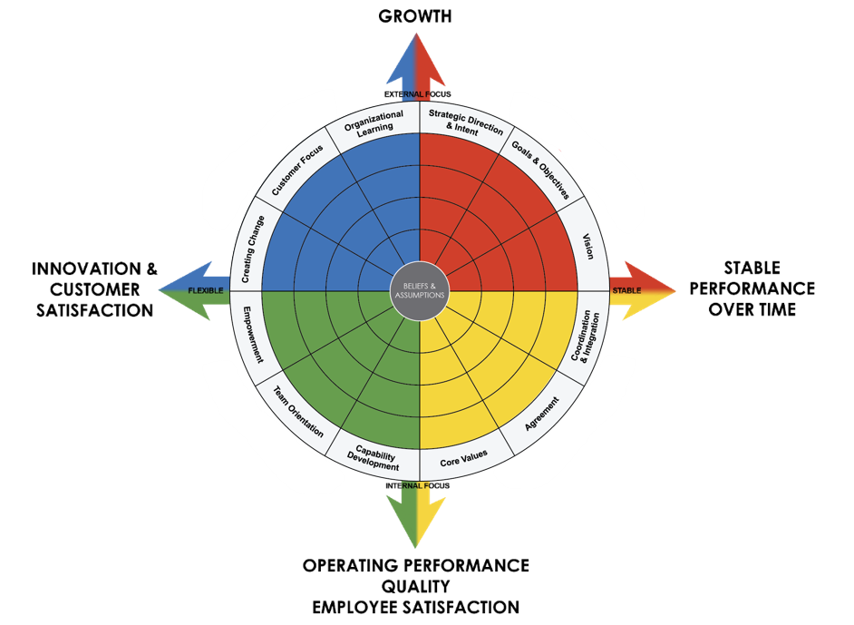
Leadership through the lens of a high-performance culture
Challenges facing leaders today are complex and often ill-defined. The Denison Model of High Performance is a model that views the culture of an organization in a ‘systemic’ way.
Culture has a significant impact on business performance across many important metrics
Leaders have a tremendous impact on the culture of an organization and thus it is critical to understand a leader’s capabilities as they relate to culture and performance

Slide 3
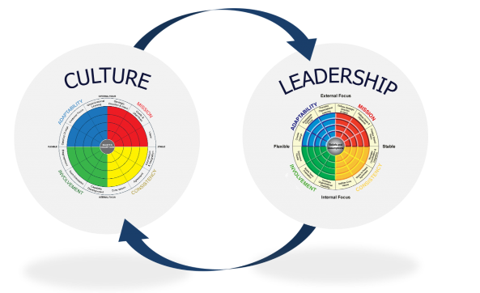
The Denison Model – “Two sides of the same coin.”
A model that allows for assessments of individual leaders, teams and organizations – all through a high-performance culture lens.

Slide 4
Importance of Listening and Learning from the data

Slide 5
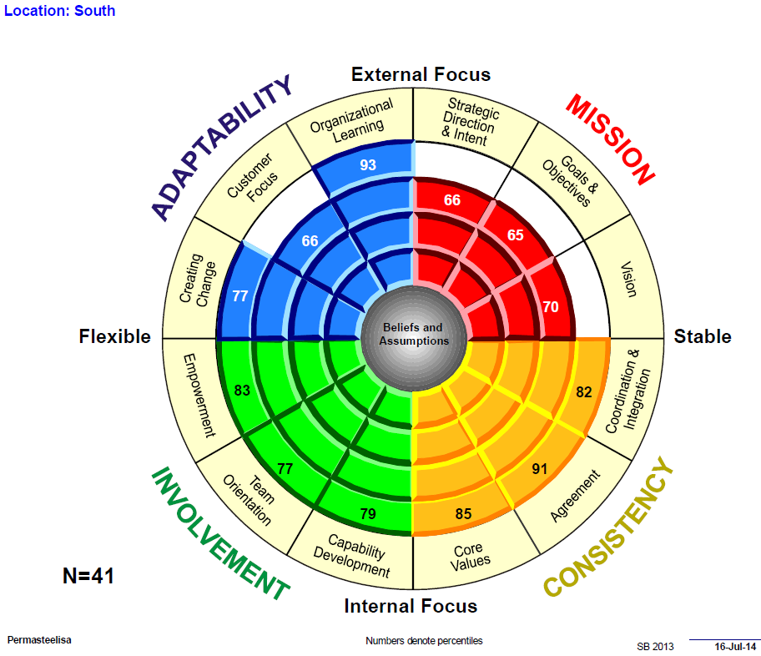
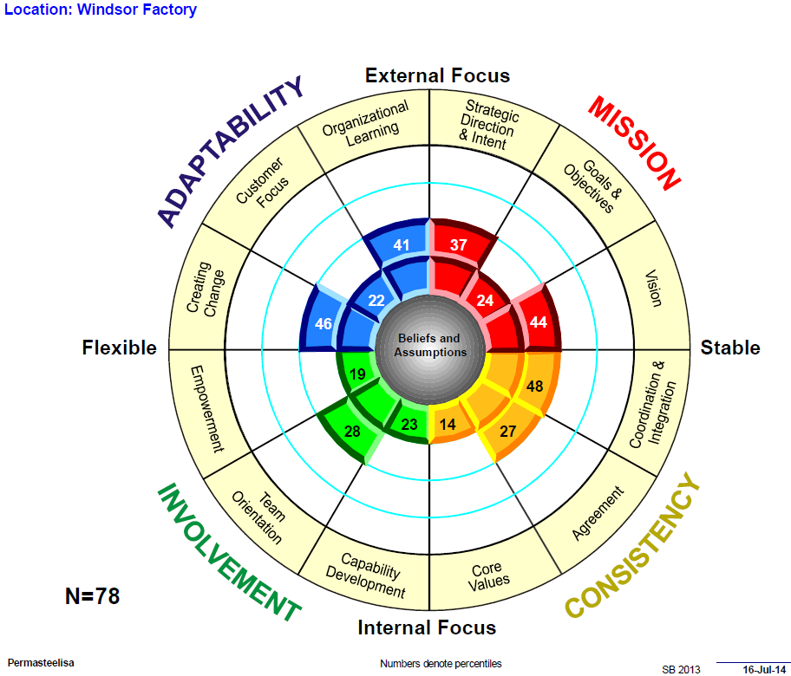
…….”But our North facility FAR OUT-PERFORMS our South facility”
South
North

Slide 6
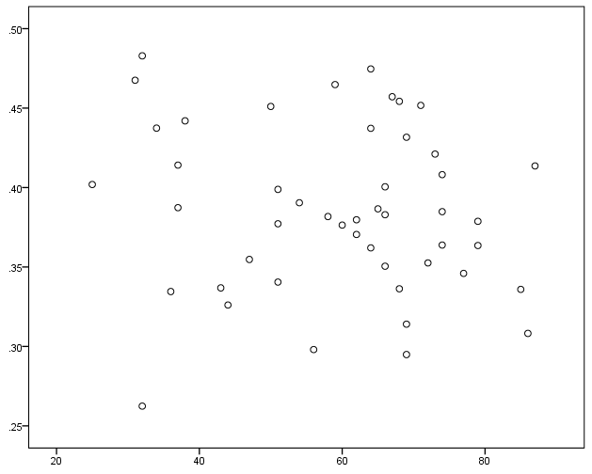
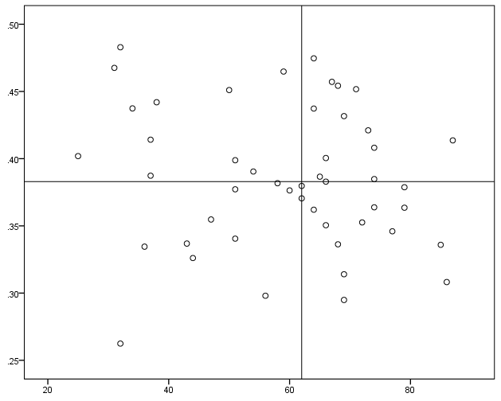
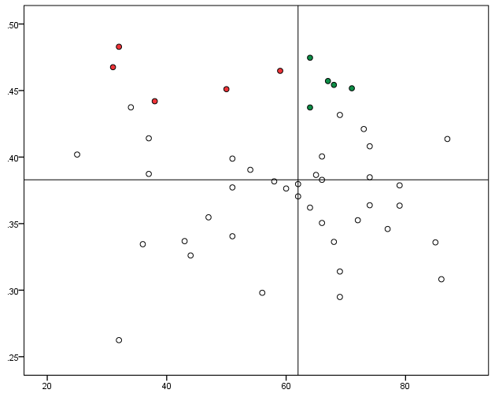
Driver Analysis – Methodology
2020: Overall
Step 1
Step 2
Step 3
The five items with the strongest relationship strength within each of the top two quadrants were identified as the top drivers of the outcome module. Items in the top right quadrant represent areas to sustain positive scores (relatively higher percentile scores) and items in the top left quadrant represent areas to improve (relatively lower percentile scores).
The scores for all items in your culture survey were plotted out based on their percentile score and the strength of their relationship with the outcome module.
Four quadrants were established by applying a median split (i.e., a division based on the middle score) on both percentile score and relationship strength, where roughly one quarter of the items fall in each quadrant.
Relationship
Strength
Relationship
Strength
Relationship
Strength
Improve
Sustain
Percentile Score
Percentile Score
Percentile Score
Note: Drivers listed on next slide

Slide 7
Top Cultural Drivers of Safety
2020: Overall
We identified cultural behaviors and values that are positively related to Safety that may provide unique points of leverage for improvement. These items were broken out into areas you should sustain positive scores (high relationship strength, relatively high percentile) and areas you have the most room to improve (high relationship strength, relatively low percentile).
Relationship Strength
PERCENTILE
UNIQUE CULTURAL DRIVERS TO SUSTAIN
“Safety is an important attitude that should & needs to be a priority focus of every teammate!”
2
83
Our vision creates excitement and motivation for our teammates.
4
92
We are able to meet short-term demands without compromising our long-term vision.
7
93
We have a shared vision of what the organization will be like in the future.
8
90
There is good alignment of goals across levels.
9
83
We continuously track our progress against our stated goals.
Safety
0
PERCENTILE
25th
50th
75th
100th
67
Relationship Strength
PERCENTILE
UNIQUE CULTURAL DRIVERS TO IMPROVE
1
74
Leaders have a long-term viewpoint.
3
78
There is a clear mission that gives meaning and direction to our work.
5
77
The leadership has clearly stated the objectives we are trying to meet.
“Convincing everyone but especially our field personnel in taking more ownership of our core values, especially safety… Complacency seems to be our biggest enemy.”
6
75
There is a long-term purpose and direction.
10
50
The leaders and managers “practice what they preach.”
NUMBERS DENOTE PERCENTILES
|
4/20/2020
|
D48NE419G-117
©Daniel R. Denison, Ph.D. All rights reserved

Slide 8
Example: Position = Engineer
2018: ENGINEER
2020: ENGINEER
YOY Change
2018: ENGINEER
YOY Change
Strategic Direction & Intent
22
11
2020: ENGINEER
There is a long-term purpose and direction.
61
95
+34
Our strategy leads other organizations to change the way they compete in the industry.
72
93
+21
Safety
There is a clear mission that gives meaning and direction to our work.
81
91
+10
64
95
+31
There is a clear strategy for the future.
69
91
+22
41
99
+58
All leaders demonstrate strong commitment to safety.
Goals & Objectives
62
98
+36
Safety is the number one priority in everything we do.
There is widespread agreement about goals.
74
97
+23
68
96
+28
We have all the tools and resources needed to work safely.
Leaders set goals that are ambitious, but realistic.
79
97
+18
53
96
+43
Teammates take personal ownership for each other's safety.
The leadership has clearly stated the objectives we are trying to meet.
70
77
+7
84
95
+11
Teammates contribute to the development of our safety practices.
We continuously track our progress against our stated goals.
79
86
+7
57
79
+22
We always work safely, even under high pressure.
We continually look for new ways to work safely.
75
95
+20
Vision
We work to gain a deep understanding of all
near-misses. (or "close calls").
We have a shared vision of what the organization will be like in the future.
80
97
+17
55
96
+41
67
98
+31
Leaders have a long-term viewpoint.
People from different parts of the organization work together
in a way that ensures their safety.
68
95
+27
Our vision creates excitement and motivation for our teammates.
71
97
+26
34
91
+57
All safety issues are reported quickly to leaders and managers.
90
99
+9
86
96
+10
We are able to meet short-term demands without compromising our long-term vision.
Leaders and managers act quickly to resolve all safety issues.
Considering everything, this organization
is a very safe place to work.
Core Values
74
96
+22
The leaders and managers “practice what they preach”.
49
92
+43
Coordination & Integration
There is good alignment of goals across levels..
86
99
+13

Slide 9
Example: Position = Equipment Operator/Driver
2018: DRIVER
2020: DRIVER
YOY Change
Strategic Direction & Intent
19
19
19
19
There is a long-term purpose and direction.
93
34
-59
Safety
92
12
-80
Our strategy leads other organizations to change the way they compete in the industry.
95
76
-19
All leaders demonstrate strong commitment to safety.
64
2
-62
There is a clear mission that gives meaning and direction to our work.
93
18
-75
Safety is the number one priority in everything we do.
93
10
-83
There is a clear strategy for the future.
97
28
-69
We have all the tools and resources needed to work safely.
97
24
-73
Goals & Objectives
90
7
-83
Teammates take personal ownership for each other's safety.
There is widespread agreement about goals.
97
56
-41
Teammates contribute to the development of our safety practices.
90
17
-73
Leaders set goals that are ambitious, but realistic.
97
15
-82
We always work safely, even under high pressure.
91
38
-53
The leadership has clearly stated the objectives we are trying to meet.
94
16
-78
We continually look for new ways to work safely.
95
17
-78
We continuously track our progress against our stated goals.
94
25
-69
We work to gain a deep understanding of all
near-misses. (or "close calls").
93
38
-55
Vision
People from different parts of the organization work together
in a way that ensures their safety.
95
18
-77
We have a shared vision of what the organization will be like in the future.
98
67
-31
70
6
-64
All safety issues are reported quickly to leaders and managers.
Leaders have a long-term viewpoint.
95
26
-69
90
12
-78
Leaders and managers act quickly to resolve all safety issues.
Our vision creates excitement and motivation for our teammates.
93
62
-31
Considering everything, this organization
is a very safe place to work.
93
15
-78
We are able to meet short-term demands without compromising our long-term vision.
98
64
-34
Core Values
The leaders and managers “practice what they preach”.
91
5
-86
Coordination & Integration
There is good alignment of goals across levels..
95
60
-35

Slide 10
Sample Team Composite Report

Slide 11
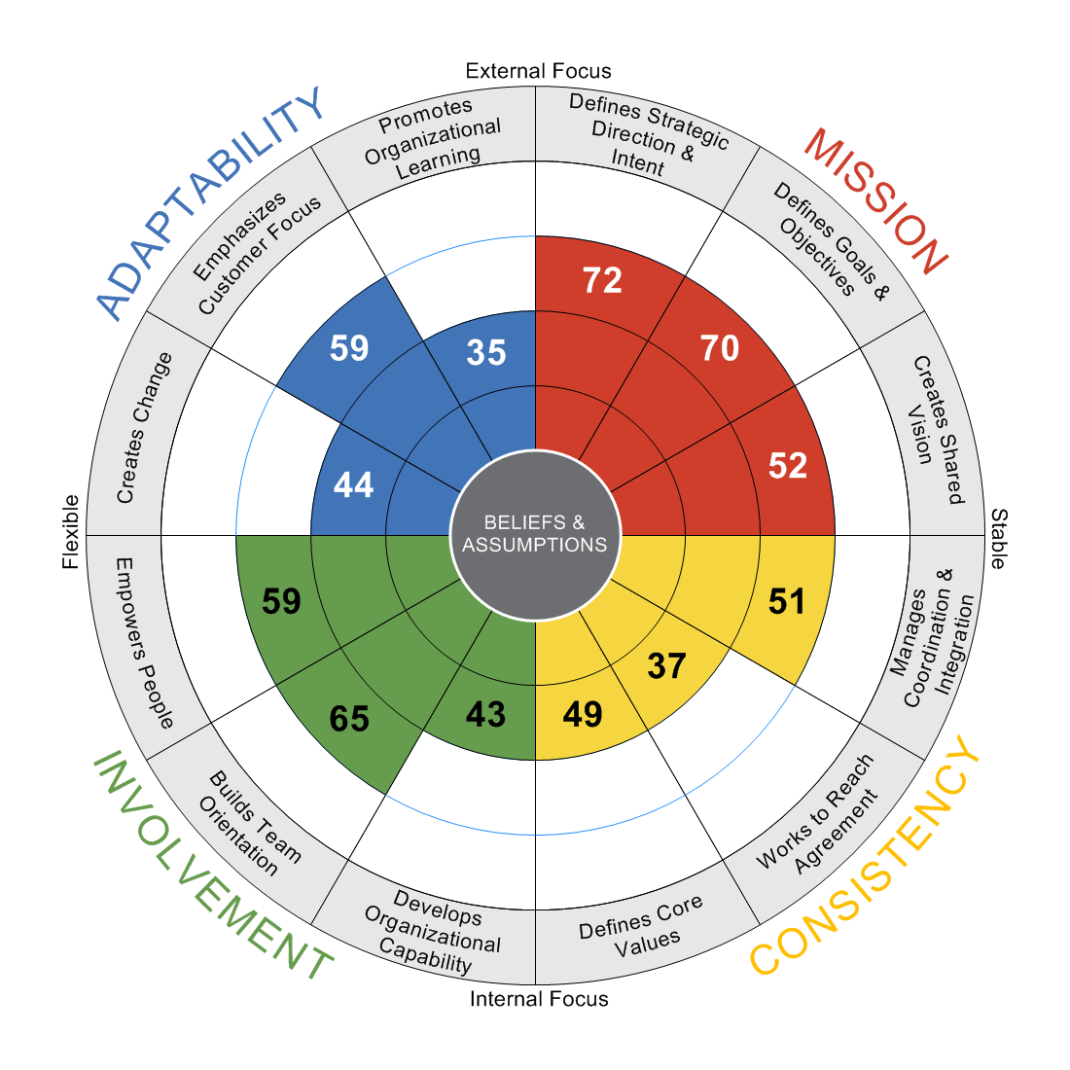
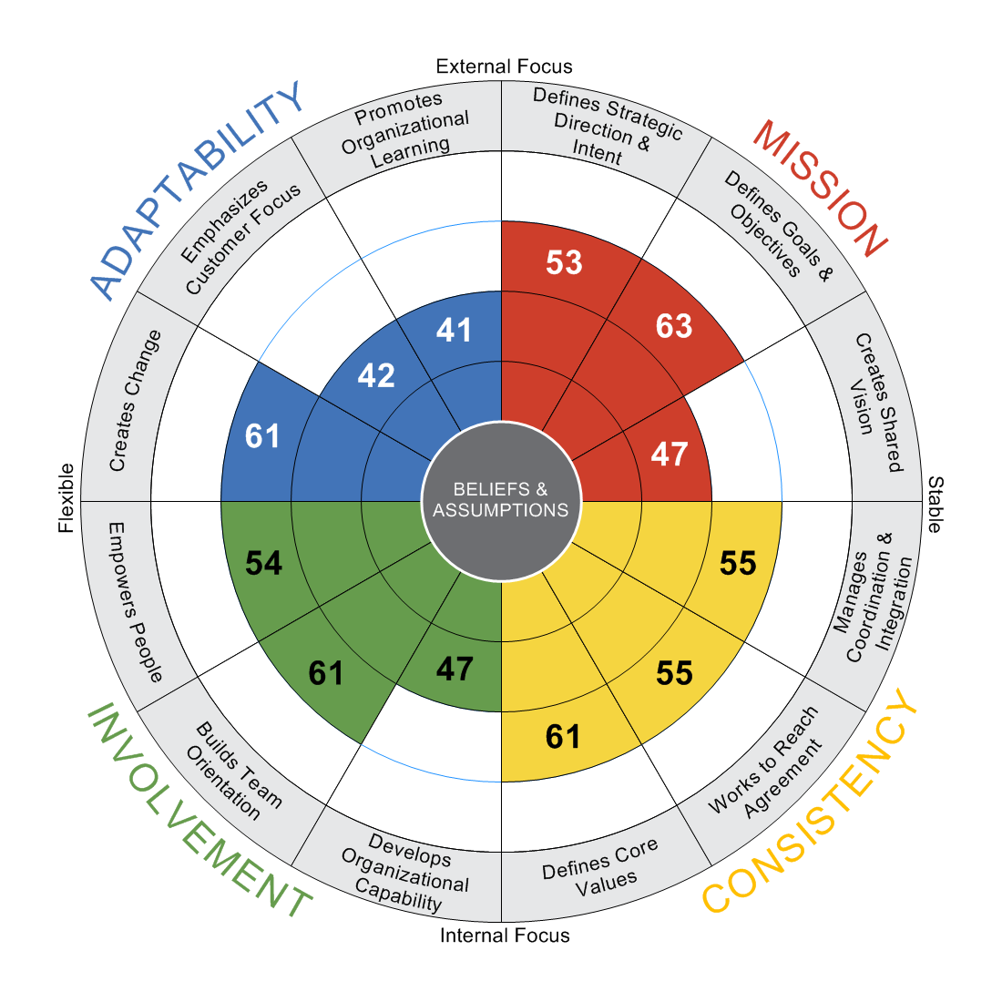
Self
Combined Other
N = 13
N = 136
NUMBERS DENOTE PERCENTILES
|
3/30/2021
|
LC6019Q4G-139
Authors: Daniel R. Denison, Ph.D. William S. Neale, M.A., M.L.I.R
©Daniel R. Denison, Ph.D. All rights reserved

Slide 12
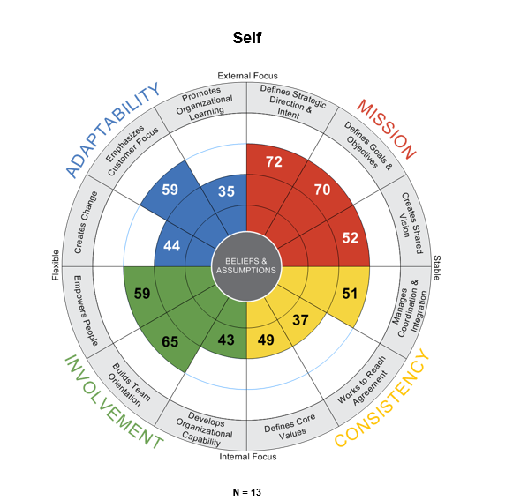
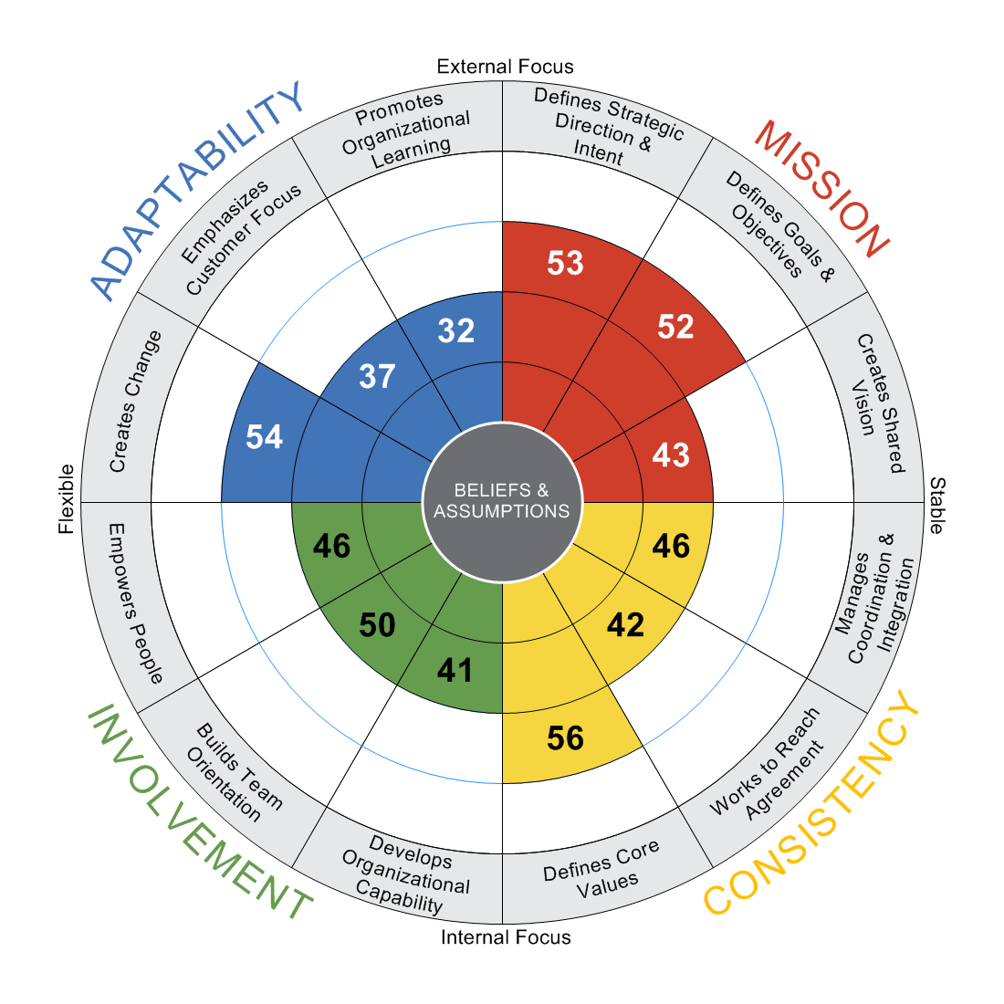
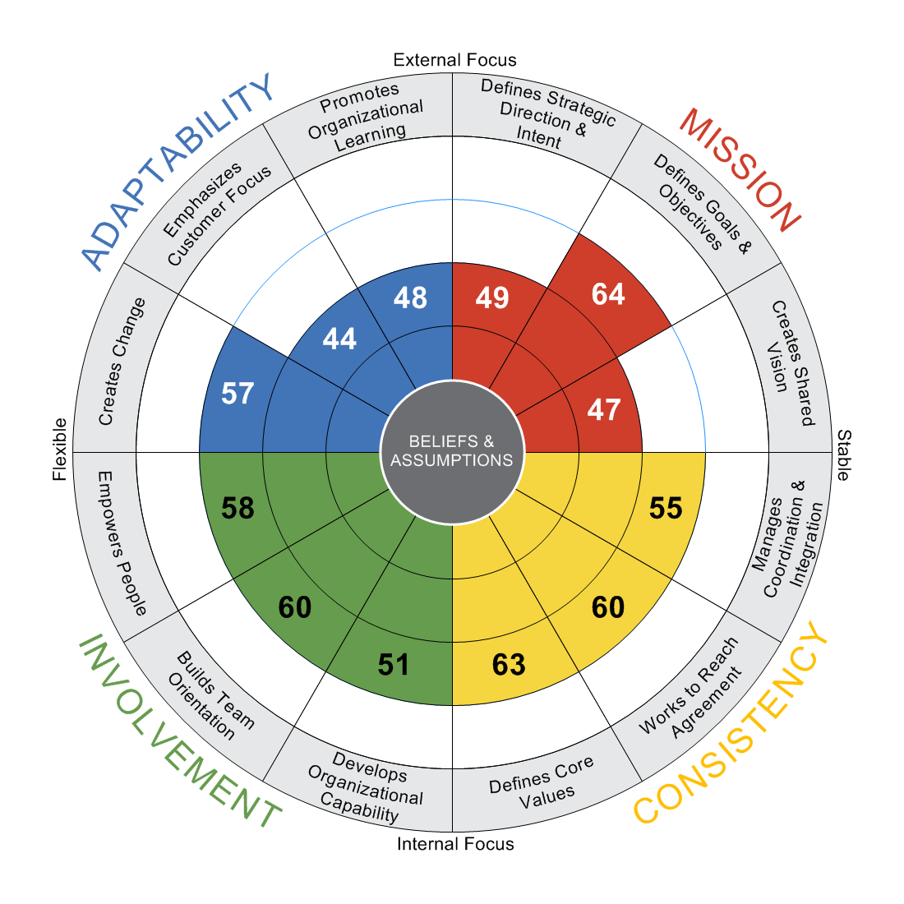
Peer
Direct Report
N = 53
N = 63
NUMBERS DENOTE PERCENTILES
|
3/31/2021
|
LC6019Q4G-139
Authors: Daniel R. Denison, Ph.D. William S. Neale, M.A., M.L.I.R
©Daniel R. Denison, Ph.D. All rights reserved

Slide 13
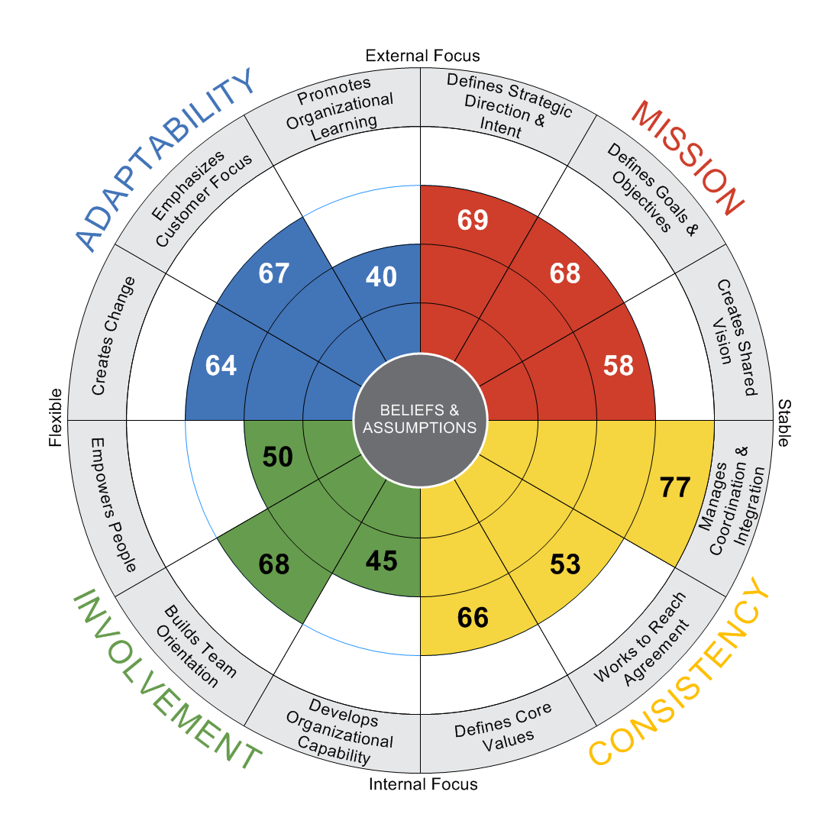
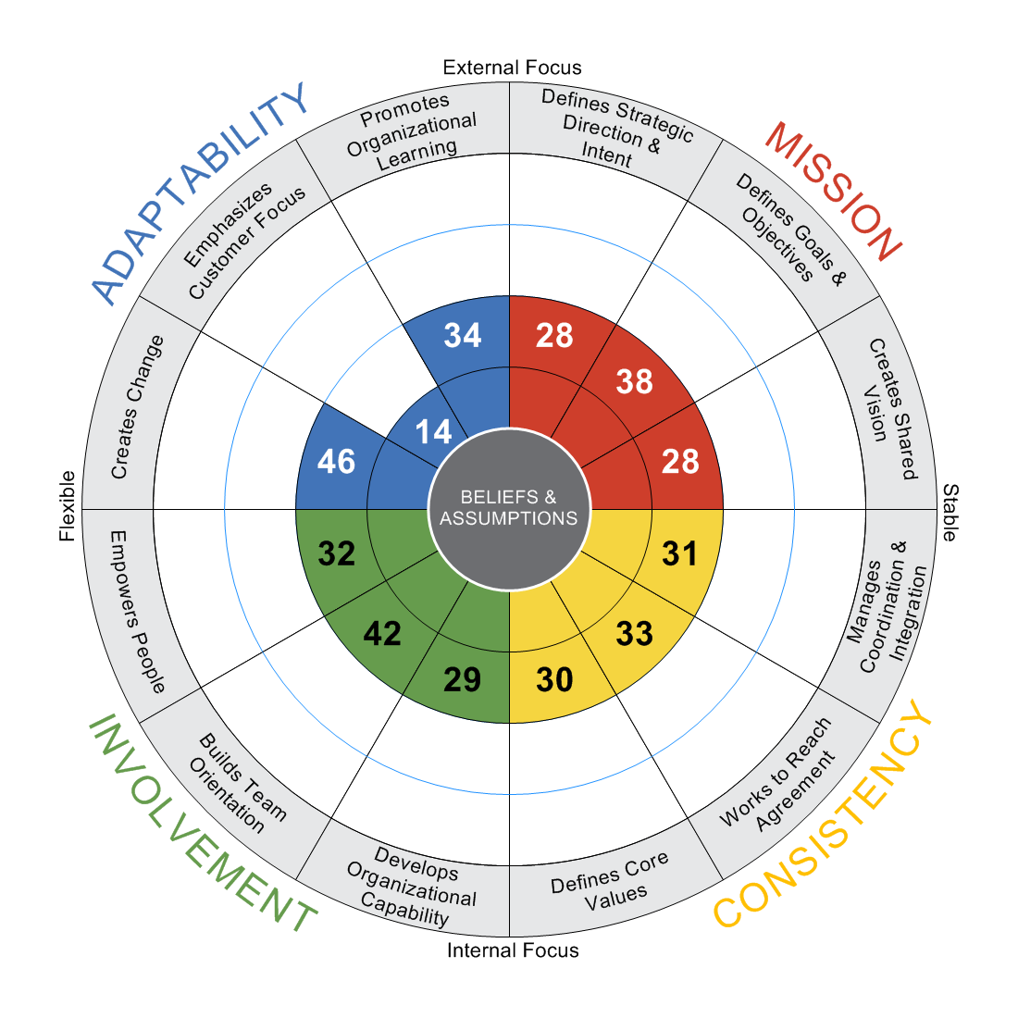
Boss
Other
N = 13
N = 7
NUMBERS DENOTE PERCENTILES
|
3/31/2021
|
LC6019Q4G-139
Authors: Daniel R. Denison, Ph.D. William S. Neale, M.A., M.L.I.R
©Daniel R. Denison, Ph.D. All rights reserved

Slide 14
Mission
Q U A R T I L E
1st
2nd
3rd
4th
Self
Combined Other
Peer
Direct Report
Other
Boss
Defines Strategic Direction & Intent
N =
13
136
53
63
7
13
Effectively allocates resources in line with strategic priorities.
84
51
49
49
37
79
Helps define strategies and tactics that keep his/her organization competitive.
33
53
49
46
37
57
Has a clear strategy for the future of his/her own part of the organization.
79
44
46
40
28
39
Is able to meet short-term demands without losing sight of the long-term strategy.
79
55
46
62
20
77
Communicates a clear and compelling rationale for the business strategy.
85
53
51
50
24
38
Defines Goals & Objectives
Holds individuals and teams accountable for achieving goals and objectives.
77
62
41
73
52
53
Provides clear directions and priorities for employees.
80
57
45
67
35
76
Tracks progress against stated goals.
81
63
42
66
38
76
Effectively communicates the goals and objectives of the organization.
33
61
58
65
32
79
Aligns goals and objectives with the strategy and vision.
82
58
58
47
31
80
Creates Shared Vision
Helps create a shared vision of what this organization will be like in the future.
58
44
36
46
29
41
Communicates the organizational vision to his/her employees.
34
52
40
52
37
60
Uses the vision to create excitement and motivation for employees.
45
46
42
47
35
47
Organizes work so that everyone sees the connection between the vision and daily activities.
46
49
48
45
32
86
Inspires others with his/her vision of the future.
48
43
45
43
21
44
NUMBERS DENOTE PERCENTILES
|
3/30/2021
|
LC6019Q4G-139
©Daniel R. Denison, Ph.D. All rights reserved

Slide 15
Consistency
Q U A R T I L E
1st
2nd
3rd
4th
Self
Combined Other
Peer
Direct Report
Other
Boss
Defines Core Values
N =
13
136
53
63
7
13
Does the "right thing" even when it is not popular.
59
68
61
64
45
66
"Practices" what s/he "preaches."
60
58
52
62
29
64
Lives up to promises and commitments.
63
60
57
67
25
54
Has earned the confidence and trust of others.
71
54
51
58
20
64
Clearly articulates a set of fundamental beliefs that are not negotiable.
31
52
62
48
50
67
Works to Reach Agreement
Helps people to reach consensus, even on difficult issues.
30
53
40
69
24
84
Incorporates diverse points of view when making decisions.
29
55
49
59
30
34
Promotes constructive discussion among people with conflicting ideas.
31
59
49
68
56
37
Is willing to compromise when necessary in order to reach agreement.
81
49
39
55
37
55
Reconciles differences by seeking to clarify and understand others' points of view.
23
52
37
66
32
79
Manages Coordination & Integration
Works hard to foster the alignment of goals across all functional areas.
79
53
40
60
34
75
Builds coordination across departmental boundaries.
52
57
47
64
25
74
Uses informal networks to get things done.
28
50
42
45
37
76
Builds support for ideas through contact with other departments.
30
56
47
43
39
79
Establishes mechanisms that facilitate effective cross-functional communication.
41
50
44
52
22
83
NUMBERS DENOTE PERCENTILES
|
3/30/2021
|
LC6019Q4G-139
©Daniel R. Denison, Ph.D. All rights reserved

Slide 16
Involvement
Q U A R T I L E
1st
2nd
3rd
4th
Self
Combined Other
Peer
Direct Report
Other
Boss
Empowers People
N =
13
136
53
63
7
13
Sees that decisions are made at the lowest possible level.
38
51
43
54
38
41
Shares information so that everyone gets the information s/he needs.
59
55
40
55
34
66
Involves everyone in shaping the plans and decisions that affect them.
53
45
40
47
37
77
Conveys confidence in people's competence to do their job.
65
58
41
60
29
72
Delegates authority so that others can do their work more effectively.
74
53
45
58
28
36
Builds Team Orientation
Builds effective teams that get the job done.
72
66
48
63
28
74
Encourages effective teamwork by others.
66
66
42
61
65
77
Knows how to use a team approach to solve problems.
75
59
45
53
35
74
Fosters teamwork within the work unit.
68
57
43
62
35
68
Values the contributions of the people s/he works with.
43
50
47
54
56
34
Develops Organizational Capability
Knows how to utilize the diversity of the workforce.
31
53
50
51
45
30
Coaches others in the development of their skills.
29
45
44
47
35
39
Helps direct reports create realistic development plans and create opportunities for them.
36
46
34
54
13
39
Uses rewards and recognition to motivate good performance.
39
33
33
39
45
33
Builds employee skills so that the organization always has good "bench strength."
32
55
47
54
26
64
NUMBERS DENOTE PERCENTILES
|
3/30/2021
|
LC6019Q4G-139
©Daniel R. Denison, Ph.D. All rights reserved

Slide 17
Adaptability
Q U A R T I L E
1st
2nd
3rd
4th
Self
Combined Other
Peer
Direct Report
Other
Boss
Creates Change
N =
13
136
53
63
7
13
Continuously looks for new and better ways to do work.
67
54
45
61
51
72
Encourages creative thinking.
40
60
63
51
70
73
Champions change that goes beyond the scope of his/her job.
53
63
55
51
57
75
Challenges organizational practices that are nonproductive.
27
52
48
50
25
53
Generates innovative ideas and solutions to problems.
35
62
54
50
41
78
Emphasizes Customer Focus
Encourages direct contact with customers.
18
36
33
31
16
64
Responds quickly and effectively to customer feedback.
69
35
28
49
11
68
Actively seeks feedback from customers.
40
41
40
39
12
76
Continuously tries to improve service to customers.
67
48
35
51
43
72
Incorporates customer input into the planning process.
78
50
43
44
14
74
Promotes Organizational Learning
Views failure as an opportunity for learning and improvement.
24
41
29
46
72
78
Creates a working environment in which learning is an important objective.
22
39
36
41
40
29
Openly accepts criticism without being defensive.
34
43
35
54
26
36
Knows the strengths and weaknesses of the competition.
41
36
34
41
11
32
Encourages others to learn about the best practices in the industry.
34
41
28
42
66
38
NUMBERS DENOTE PERCENTILES
|
3/30/2021
|
LC6019Q4G-139
©Daniel R. Denison, Ph.D. All rights reserved

Slide 18
Highest & Lowest Scores
Combined Other
HIGHEST SCORES
68
Does the "right thing" even when it is not popular.
66
Builds effective teams that get the job done.
66
Encourages effective teamwork by others.
63
Tracks progress against stated goals.
63
Champions change that goes beyond the scope of his/her job.
62
Generates innovative ideas and solutions to problems.
62
Holds individuals and teams accountable for achieving goals and objectives.
61
Effectively communicates the goals and objectives of the organization.
60
Lives up to promises and commitments.
60
Encourages creative thinking.
LOWEST SCORES
33
Uses rewards and recognition to motivate good performance.
35
Responds quickly and effectively to customer feedback.
36
Encourages direct contact with customers.
36
Knows the strengths and weaknesses of the competition.
39
Creates a working environment in which learning is an important objective.
41
Views failure as an opportunity for learning and improvement.
41
Encourages others to learn about the best practices in the industry.
41
Actively seeks feedback from customers.
43
Inspires others with his/her vision of the future.
43
Openly accepts criticism without being defensive.
NUMBERS DENOTE PERCENTILES
|
3/30/2021
|
LC6019Q4G-139
©Daniel R. Denison, Ph.D. All rights reserved

Slide 19
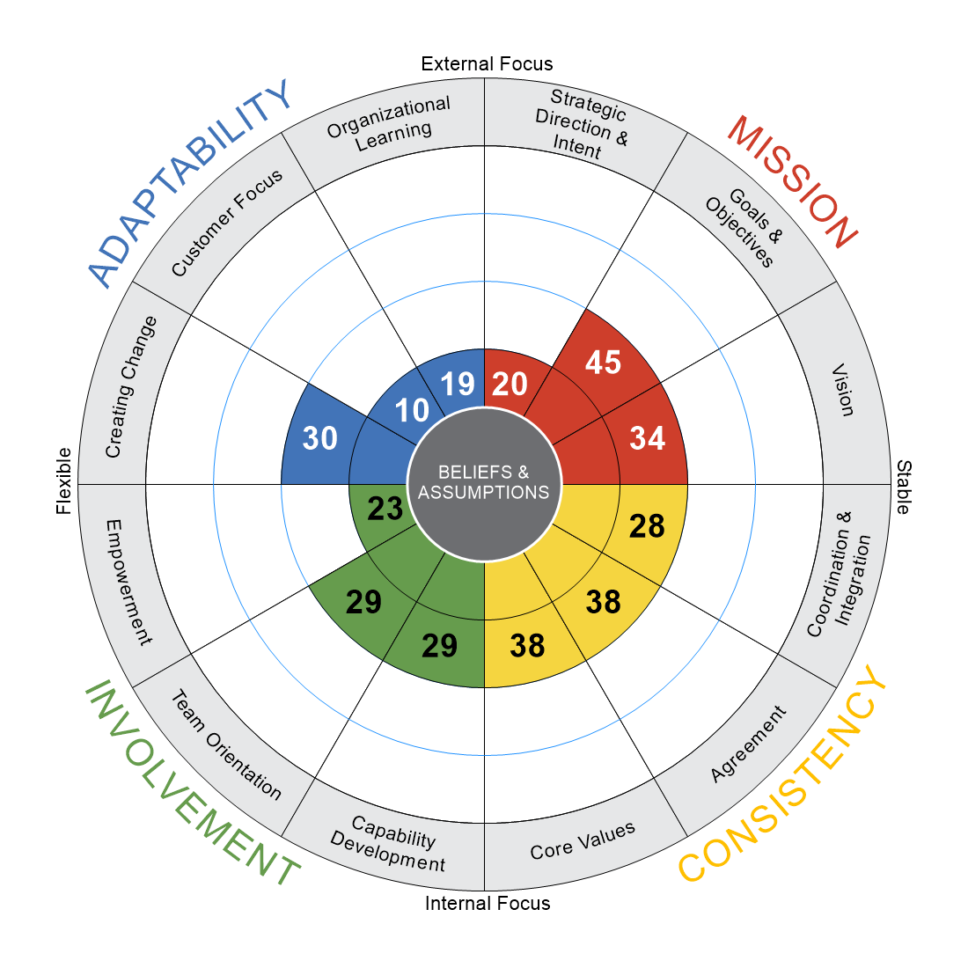
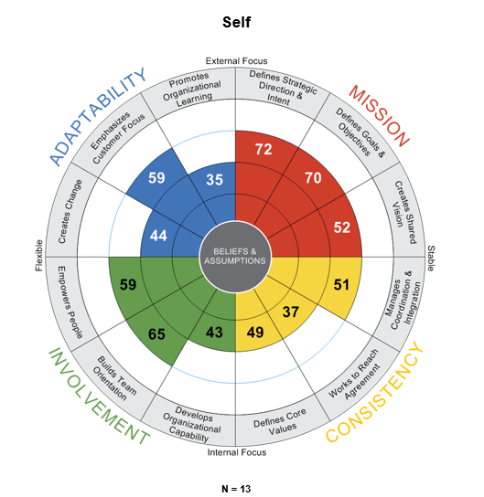
2022: Overall Culture
Combined Other
N = 678
Response Rate:
678 of 802 (85 %)
Note: EE n/a responses are not included in percentile calculations
N = 136

Slide 20
Leadership Coaching Process

Slide 21
Leadership Coaching
Session 1 – Overview Model and Benchmark, Review Results and insights
  Assign Leader to Select 2-3 Focus Areas and begin having conversations with raters about the data
Session 2 – (60-day check-in) : Overview Focus Areas and Actions taken so far
Session 3 – (90-day check-in): Discuss progress and course-correct if needed

