Slide 1
WELCOME: Thoughts and Discussion Regarding Culture in M&A’s Bryan Adkins, CEO badkins@denisonculture.com

Slide 2
Some Context
M&A activity hit new heights in 2021
Through the pandemic, M&A activity persevered, though deals generally took longer to close
A shift was noted from a seller to buyer market
Increase in what is described as strategic buyers (vs. financial)
Uncertainties in market are driving more emphasis on due diligence
Supply chains
Technology
Business Model
and yes…CULTURE

Slide 3
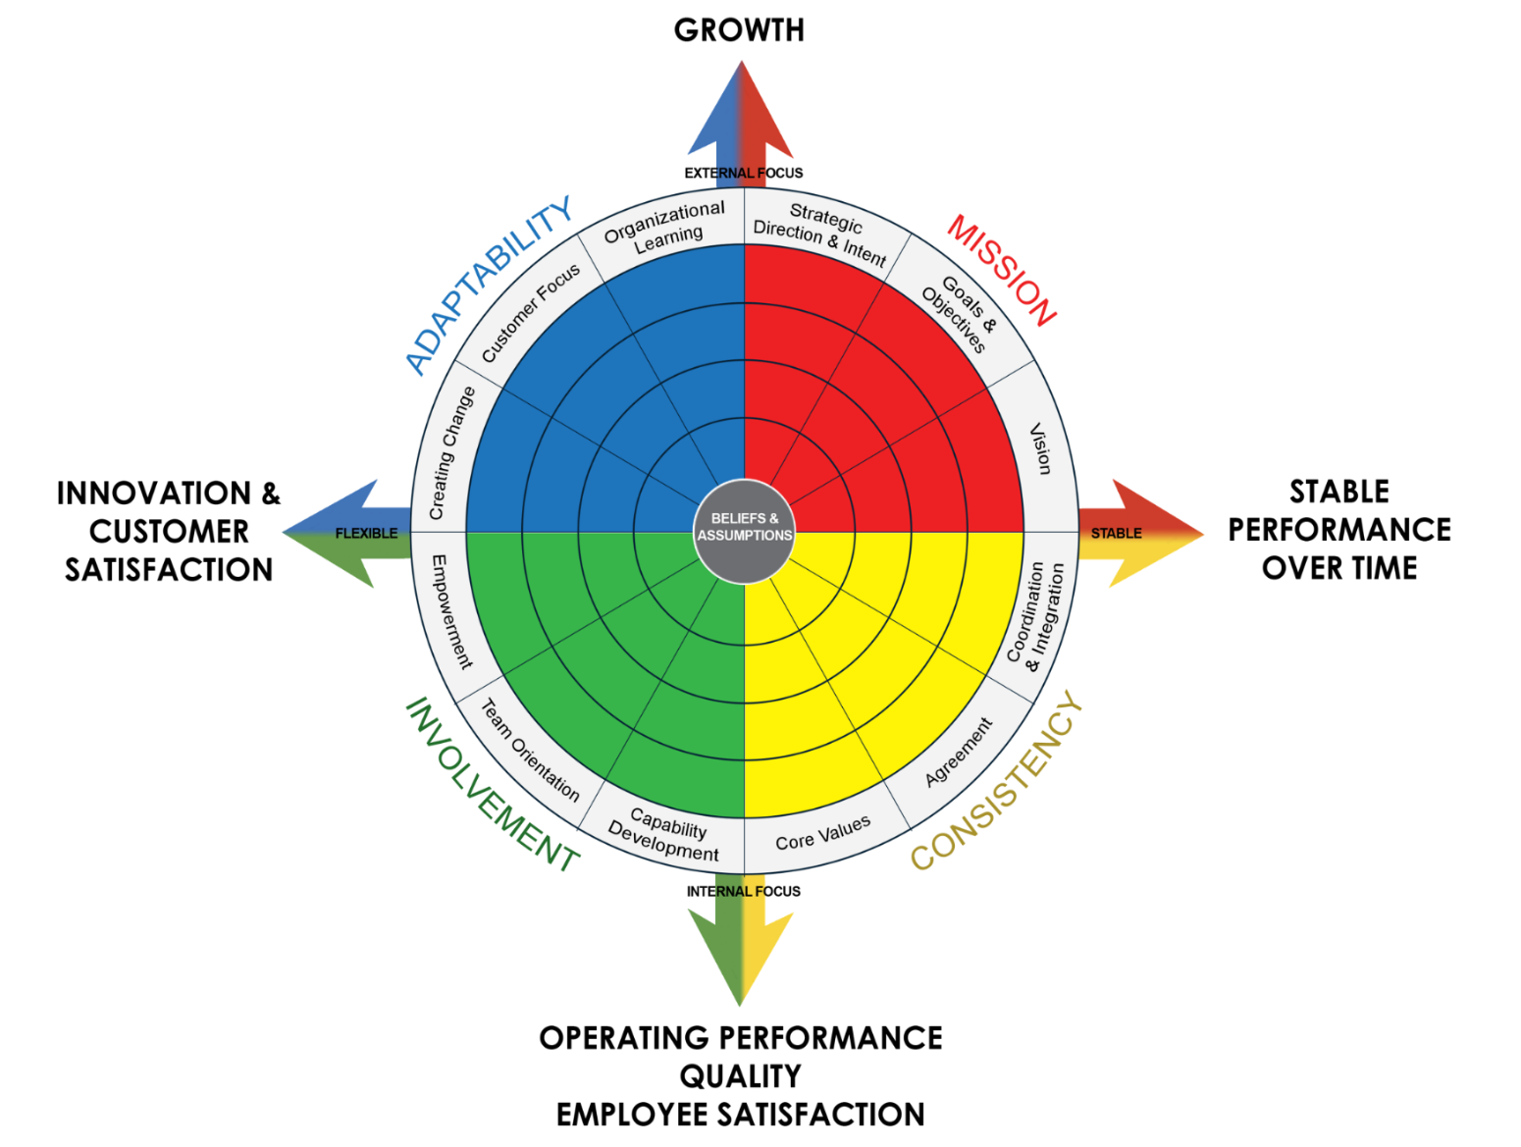
A Few Fundamental Recommendations
Focus on areas of consequence - Practices, habits and behaviors that impact performance
More data is better than less – Seek to understand both the practices/habits developed over time AND the associated underlying beliefs and assumptions
Try to clarify the level of integration expected – we use a model (Mirvis & Marks) to understand whether leaders see the integration as an absorption, stand-alone, best-of-both, transformational, or reverse merger
Sales Growth
Market Share
Innovation
Customer Satisfaction
Financial Performance
Quality
Employee Satisfaction & Engagement

Slide 4
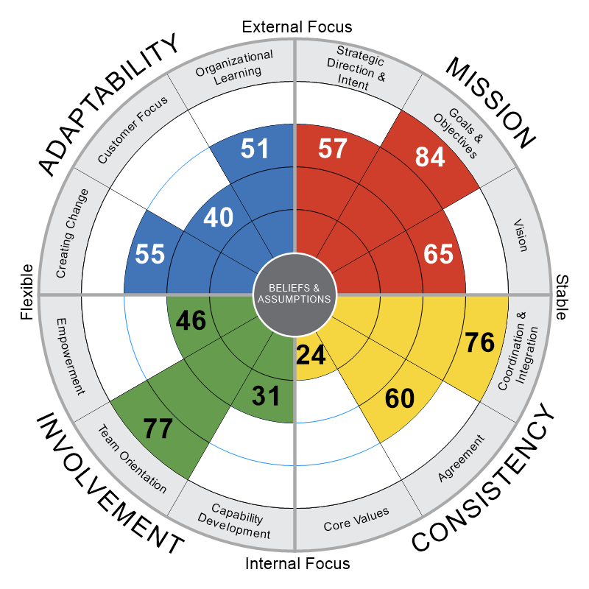
Culture: Being Intentional & Explicit
There is a strong goal orientation, though more could be done to link the goals to the strategies and vision. Emphasis is more short-term.
Collaboration within and across teams is emphasized – it is critical to be seen as a team player.
There are core values, however they are rarely talked about or reinforced.
Development of the workforce is not the highest priority.
The customer perspective is not very well understood or considered as decisions are made.
The effective development and sustainment of Culture requires intention, and the ability to make explicit what is too often implicit

Slide 5
Agenda
M&A Integration:
Understanding the Potential

Slide 6
Identifying Potential…
Areas of Leverage – Cultural areas that both organizations seem to value and demonstrate
Best Practices – Cultural strengths that one organization has that are missing or underutilized by the other organization – that can be captured and shared
3. Areas of Weakness – Cultural areas where neither organization has demonstrated capabilities today, and that need mutual development to maximize performance

Slide 7
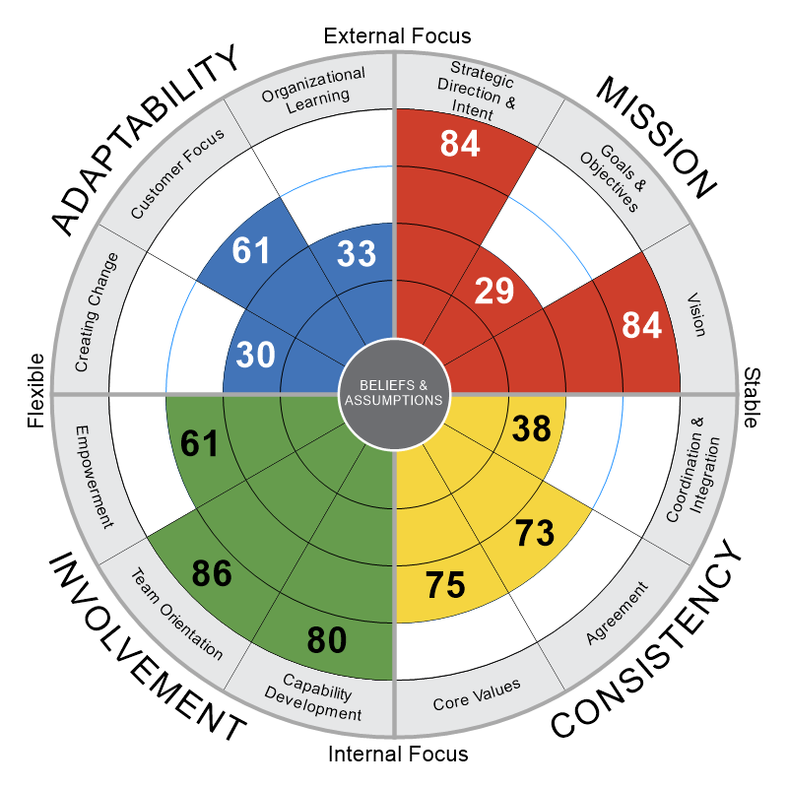
Potential Leverage
The areas noted reflect mutual strengths (Team Orientation, Agreement and Vision).
Neither organization needs to convince the other that these are important.
However, because they are strengths, they will be valued, and any change to how these are practiced will need to be introduced and executed with care.
ABC Co.
XYZ Co.

Slide 8
Potential Best Practices
ABC Co.
XYZ Co.
Here we have highlighted strengths for ABC or XYZ Co., areas that are not as apparent at the other company. There is an opportunity to bring some best practices forward in to the combined company.

Slide 9
Potential Areas of Weakness
ABC Co.
XYZ Co.
‘Areas of Weakness’ reflect areas for which neither organization has created strong alignment or capability to-date. In this example both companies are at or below average regarding Creating Change and Organizational Learning - areas that will be severely tested when integrating two companies.

Slide 10
Agenda
Questions & Discussion
Impact of more virtual/hybrid work environments on M&A integration?
When and how do you make culture more explicit?
Being explicit about…
Goal clarity & Accountability
Collaboration
Trust
Etc.

