Slide 1
Company Name
2021 Organizational Culture Survey
Diversity & Inclusion Driver Analysis: Demographic Report

Slide 2
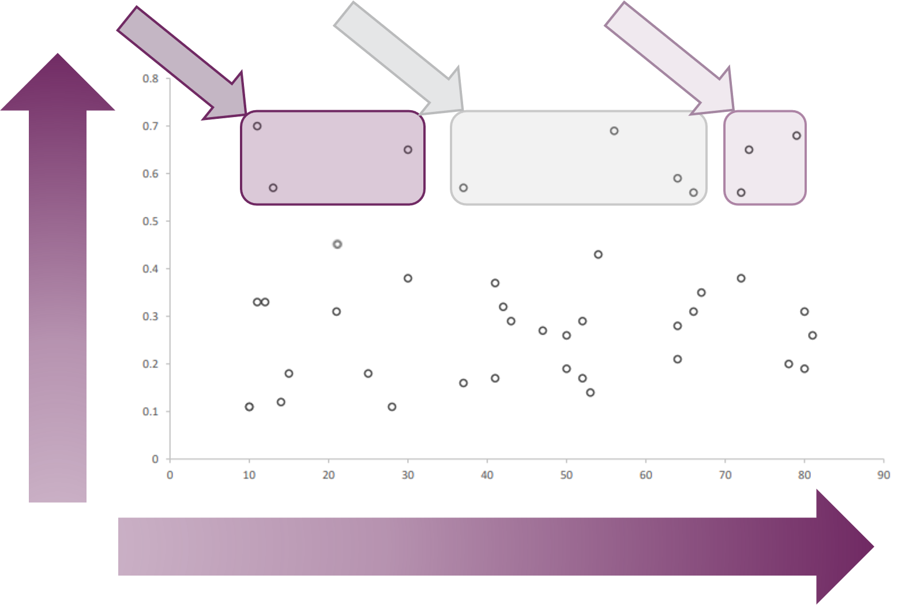
Driver Analysis Methodology
Your culture survey items are plotted based on their Culture Benchmark Score and the strength of their relationship with your Content Module score. The ten strongest ‘Cultural Drivers’ of your Content Module Score are then interpreted by their Culture Benchmark Score. *Improve* items are your Cultural Drivers with the most opportunity to progress. *Monitor* items may not have as much area for growth as your Improve items, but they are unique Cultural Drivers that can help prioritize actions in your transformation journey. *Sustain* items are your Cultural Drivers with the most progress made so far.
Improve
Monitor
Sustain
Relationship Strength
Culture Benchmark Score
Relationship Strength between Culture Benchmark Scores and Content Module Scores is measured with correlation values

Slide 3
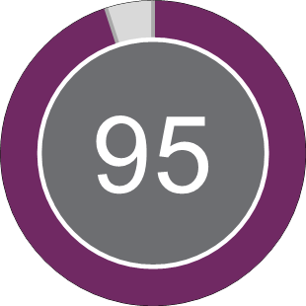
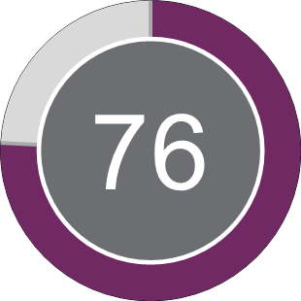
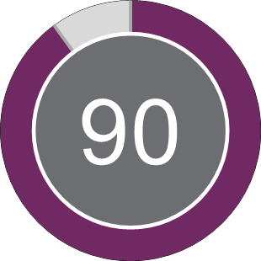
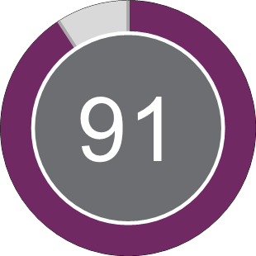
Diversity & Inclusion
2021: Driver Analysis Overall Scores by Race
White
Asian
Black or African American
Overall Diversity & Inclusion Score
Overall Diversity & Inclusion Score
Overall Diversity & Inclusion Score
N = 498
N = 31
N = 36
Hispanic or Latino
Native Hawaiian or Other Pacific Islander
Two or more races (Not Hispanic or Latino)
Overall Diversity & Inclusion Score
Overall Diversity & Inclusion Score
Overall Diversity & Inclusion Score
N = 69
N = 4
N = 25
8/25/2022 | MDI1019Q3G-120

Slide 4
Company Name
Organizational Culture Survey
2021: White

Slide 5
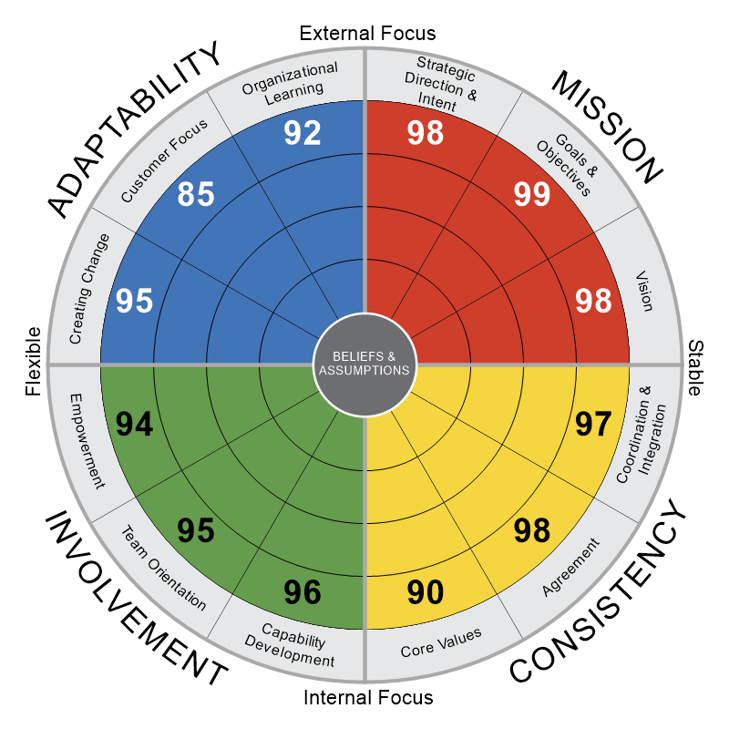
2021: White
N = 498
NUMBERS DENOTE PERCENTILES
|
8/25/2022
|
D48NE419G-117
Authors: Daniel R. Denison, Ph.D. William S. Neale, M.A., M.L.I.R
©Daniel R. Denison, Ph.D. All rights reserved

Slide 6
Diversity & Inclusion
2021: White
The Diversity & Inclusion module measures how effectively an organization fosters diversity (diverse representation of people) and inclusion (an inclusive and supportive work environment). The module includes four areas: (1) perceptions of inclusion and respect, (2) a workplace free of discrimination, (3) fair and equal access to opportunities, and (4) leadership commitment to diversity values.
In this organization...
PERCENTILE
0
25th
50th
75th
100th
Diversity & Inclusion
95
People with different backgrounds are treated with respect.
99
People with different backgrounds are made to feel included and like they belong.
93
Even subtle forms of discrimination are not tolerated.
89
Our recruiting and hiring practices enhance our diversity.
84
People with different backgrounds have fair and equal access to personal and professional development.
99
People with different backgrounds have fair and equal opportunities for promotion.
92
There is good support for learning about diversity.
99
We can be proud of our diversity.
86
Leaders are committed to diversity and inclusion as top priorities.
95
We do a good job of rewarding positive diversity efforts.
99
QUARTILE
1st
2nd
3rd
4th
8/25/2022 | MDI1019Q3G-120

Slide 7
Top Cultural Drivers of Diversity & Inclusion
2021: White
We've identified cultural behaviors and values driving Diversity & Inclusion that may provide unique points of leverage for your transformation. *Improve* items are your Cultural Drivers with the most opportunity to progress. *Monitor* items may not have as much area for growth as your Improve items, but they are unique Cultural Drivers that can help prioritize actions in your transformation journey. *Sustain* items are your cultural strengths driving Diversity & Inclusion that you can leverage to drive change.
Culture Index | Cultural Drivers of Diversity & Inclusion to *Improve* | Correlation | Benchmark Percentile
Strategic Direction & Intent | There is a clear mission that gives meaning and direction to our work. | 0.55 | 93
Organizational Learning | We view failure as an opportunity for learning and improvement. | 0.53 | 86
Organizational Learning | Learning is an important objective in our day-to-day work. | 0.53 | 90
Culture Index | Cultural Drivers of Diversity & Inclusion to *Monitor* | Correlation | Benchmark Percentile
Vision | Our vision creates excitement and motivation for our employees. | 0.59 | 95
Vision | Leaders have a long-term viewpoint. | 0.54 | 95
Core Values | The leaders and managers "practice what they preach." | 0.54 | 94
Strategic Direction & Intent | There is a long-term purpose and direction. | 0.53 | 94
Culture Index | Cultural Drivers of Diversity & Inclusion to *Sustain* | Correlation | Benchmark Percentile
Vision | We have a shared vision of what the organization will be like in the future. | 0.55 | 98
Agreement | There is a clear agreement about the right way and the wrong way to do things. | 0.54 | 96
Agreement | There is a clearly defined culture. | 0.53 | 97
Overall Diversity & Inclusion Score
You're scoring higher than 95% of the organizations in our Diversity & Inclusion Benchmark.
8/25/2022 | N = 498

Slide 8
Company Name
Organizational Culture Survey
2021: Asian

Slide 9
2021: Asian
N = 31
NUMBERS DENOTE PERCENTILES
|
8/25/2022
|
D48NE419G-117
Authors: Daniel R. Denison, Ph.D. William S. Neale, M.A., M.L.I.R
©Daniel R. Denison, Ph.D. All rights reserved

Slide 10
Diversity & Inclusion
2021: Asian
The Diversity & Inclusion module measures how effectively an organization fosters diversity (diverse representation of people) and inclusion (an inclusive and supportive work environment). The module includes four areas: (1) perceptions of inclusion and respect, (2) a workplace free of discrimination, (3) fair and equal access to opportunities, and (4) leadership commitment to diversity values.
In this organization...
PERCENTILE
0
25th
50th
75th
100th
Diversity & Inclusion
99
People with different backgrounds are treated with respect.
99
People with different backgrounds are made to feel included and like they belong.
95
Even subtle forms of discrimination are not tolerated.
92
Our recruiting and hiring practices enhance our diversity.
99
People with different backgrounds have fair and equal access to personal and professional development.
99
People with different backgrounds have fair and equal opportunities for promotion.
84
There is good support for learning about diversity.
99
We can be proud of our diversity.
90
Leaders are committed to diversity and inclusion as top priorities.
96
We do a good job of rewarding positive diversity efforts.
99
QUARTILE
1st
2nd
3rd
4th
8/25/2022 | MDI1019Q3G-120

Slide 11
Top Cultural Drivers of Diversity & Inclusion
2021: Asian
We've identified cultural behaviors and values driving Diversity & Inclusion that may provide unique points of leverage for your transformation. *Improve* items are your Cultural Drivers with the most opportunity to progress. *Monitor* items may not have as much area for growth as your Improve items, but they are unique Cultural Drivers that can help prioritize actions in your transformation journey. *Sustain* items are your cultural strengths driving Diversity & Inclusion that you can leverage to drive change.
Culture Index | Cultural Drivers of Diversity & Inclusion to *Improve* | Correlation | Benchmark Percentile
Organizational Learning | We view failure as an opportunity for learning and improvement. | 0.78 | 96
Empowerment | Information is widely shared so that everyone can get the information he or she needs when it's needed. | 0.7 | 96
Core Values | The leaders and managers "practice what they preach." | 0.69 | 96
Capability Development | There is continuous investment in the skills of employees. | 0.68 | 96
Culture Index | Cultural Drivers of Diversity & Inclusion to *Monitor* | Correlation | Benchmark Percentile
Empowerment | Decisions are usually made at the level where the best information is available. | 0.77 | 97
Culture Index | Cultural Drivers of Diversity & Inclusion to *Sustain* | Correlation | Benchmark Percentile
Core Values | There is a clear and consistent set of values that governs the way we do business. | 0.77 | 98
Team Orientation | Work is organized so that each person can see the relationship between his or her job and the goals of the organization. | 0.76 | 98
Strategic Direction & Intent | There is a long-term purpose and direction. | 0.76 | 98
Organizational Learning | We make certain that everyone is informed about what is going on across the organization. | 0.75 | 99
Vision | We have a shared vision of what the organization will be like in the future. | 0.7 | 99
Overall Diversity & Inclusion Score
You're scoring higher than 99% of the organizations in our Diversity & Inclusion Benchmark.
8/25/2022 | N = 31

Slide 12
Company Name
Organizational Culture Survey
2021: Black or African American

Slide 13
2021: Black or African American
N = 36
NUMBERS DENOTE PERCENTILES
|
8/25/2022
|
D48NE419G-117
Authors: Daniel R. Denison, Ph.D. William S. Neale, M.A., M.L.I.R
©Daniel R. Denison, Ph.D. All rights reserved

Slide 14
Diversity & Inclusion
2021: Black or African American
The Diversity & Inclusion module measures how effectively an organization fosters diversity (diverse representation of people) and inclusion (an inclusive and supportive work environment). The module includes four areas: (1) perceptions of inclusion and respect, (2) a workplace free of discrimination, (3) fair and equal access to opportunities, and (4) leadership commitment to diversity values.
In this organization...
PERCENTILE
0
25th
50th
75th
100th
Diversity & Inclusion
76
People with different backgrounds are treated with respect.
57
People with different backgrounds are made to feel included and like they belong.
53
Even subtle forms of discrimination are not tolerated.
75
Our recruiting and hiring practices enhance our diversity.
82
People with different backgrounds have fair and equal access to personal and professional development.
81
People with different backgrounds have fair and equal opportunities for promotion.
54
There is good support for learning about diversity.
84
We can be proud of our diversity.
80
Leaders are committed to diversity and inclusion as top priorities.
89
We do a good job of rewarding positive diversity efforts.
92
QUARTILE
1st
2nd
3rd
4th
8/25/2022 | MDI1019Q3G-120

Slide 15
Top Cultural Drivers of Diversity & Inclusion
2021: Black or African American
We've identified cultural behaviors and values driving Diversity & Inclusion that may provide unique points of leverage for your transformation. *Improve* items are your Cultural Drivers with the most opportunity to progress. *Monitor* items may not have as much area for growth as your Improve items, but they are unique Cultural Drivers that can help prioritize actions in your transformation journey. *Sustain* items are your cultural strengths driving Diversity & Inclusion that you can leverage to drive change.
Culture Index | Cultural Drivers of Diversity & Inclusion to *Improve* | Correlation | Benchmark Percentile
Empowerment | Everyone believes that he or she can have a positive impact. | 0.59 | 83
Team Orientation | Teamwork is used to get work done, rather than hierarchy. | 0.58 | 90
Core Values | When people ignore core values, they are held accountable. | 0.57 | 75
Culture Index | Cultural Drivers of Diversity & Inclusion to *Monitor* | Correlation | Benchmark Percentile
Capability Development | The "bench strength" (capability of people) is constantly improving. | 0.64 | 91
Team Orientation | People work like they are part of a team. | 0.63 | 96
Coordination & Integration | There is good alignment of goals across levels. | 0.55 | 97
Vision | Leaders have a long-term viewpoint. | 0.55 | 98
Culture Index | Cultural Drivers of Diversity & Inclusion to *Sustain* | Correlation | Benchmark Percentile
Vision | We have a shared vision of what the organization will be like in the future. | 0.66 | 99
Organizational Learning | We make certain that everyone is informed about what is going on across the organization. | 0.64 | 99
Goals & Objectives | The leadership has clearly stated the objectives we are trying to meet. | 0.6 | 99
Overall Diversity & Inclusion Score
You're scoring higher than 76% of the organizations in our Diversity & Inclusion Benchmark.
8/25/2022 | N = 36

Slide 16
Company Name
Organizational Culture Survey
2021: Hispanic or Latino

Slide 17
2021: Hispanic or Latino
N = 69
NUMBERS DENOTE PERCENTILES
|
8/25/2022
|
D48NE419G-117
Authors: Daniel R. Denison, Ph.D. William S. Neale, M.A., M.L.I.R
©Daniel R. Denison, Ph.D. All rights reserved

Slide 18
Diversity & Inclusion
2021: Hispanic or Latino
The Diversity & Inclusion module measures how effectively an organization fosters diversity (diverse representation of people) and inclusion (an inclusive and supportive work environment). The module includes four areas: (1) perceptions of inclusion and respect, (2) a workplace free of discrimination, (3) fair and equal access to opportunities, and (4) leadership commitment to diversity values.
In this organization...
PERCENTILE
0
25th
50th
75th
100th
Diversity & Inclusion
90
People with different backgrounds are treated with respect.
84
People with different backgrounds are made to feel included and like they belong.
79
Even subtle forms of discrimination are not tolerated.
88
Our recruiting and hiring practices enhance our diversity.
84
People with different backgrounds have fair and equal access to personal and professional development.
87
People with different backgrounds have fair and equal opportunities for promotion.
87
There is good support for learning about diversity.
91
We can be proud of our diversity.
80
Leaders are committed to diversity and inclusion as top priorities.
84
We do a good job of rewarding positive diversity efforts.
92
QUARTILE
1st
2nd
3rd
4th
8/25/2022 | MDI1019Q3G-120

Slide 19
Top Cultural Drivers of Diversity & Inclusion
2021: Hispanic or Latino
We've identified cultural behaviors and values driving Diversity & Inclusion that may provide unique points of leverage for your transformation. *Improve* items are your Cultural Drivers with the most opportunity to progress. *Monitor* items may not have as much area for growth as your Improve items, but they are unique Cultural Drivers that can help prioritize actions in your transformation journey. *Sustain* items are your cultural strengths driving Diversity & Inclusion that you can leverage to drive change.
Culture Index | Cultural Drivers of Diversity & Inclusion to *Improve* | Correlation | Benchmark Percentile
Capability Development | The capabilities of people are viewed as an important source of competitive advantage. | 0.77 | 90
Core Values | When people ignore core values, they are held accountable. | 0.73 | 87
Customer Focus | All members have a deep understanding of customer wants and needs. | 0.7 | 91
Culture Index | Cultural Drivers of Diversity & Inclusion to *Monitor* | Correlation | Benchmark Percentile
Capability Development | The "bench strength" (capability of people) is constantly improving. | 0.73 | 94
Empowerment | Everyone believes that he or she can have a positive impact. | 0.67 | 93
Vision | Leaders have a long-term viewpoint. | 0.67 | 94
Organizational Learning | We view failure as an opportunity for learning and improvement. | 0.66 | 92
Culture Index | Cultural Drivers of Diversity & Inclusion to *Sustain* | Correlation | Benchmark Percentile
Goals & Objectives | Leaders set goals that are ambitious, but realistic. | 0.71 | 97
Vision | Our vision creates excitement and motivation for our employees. | 0.69 | 97
Agreement | There is a clear agreement about the right way and the wrong way to do things. | 0.67 | 97
Overall Diversity & Inclusion Score
You're scoring higher than 90% of the organizations in our Diversity & Inclusion Benchmark.
8/25/2022 | N = 69

Slide 20
Company Name
Organizational Culture Survey
2021: Native Hawaiian or Other Pacific Islander

Slide 21
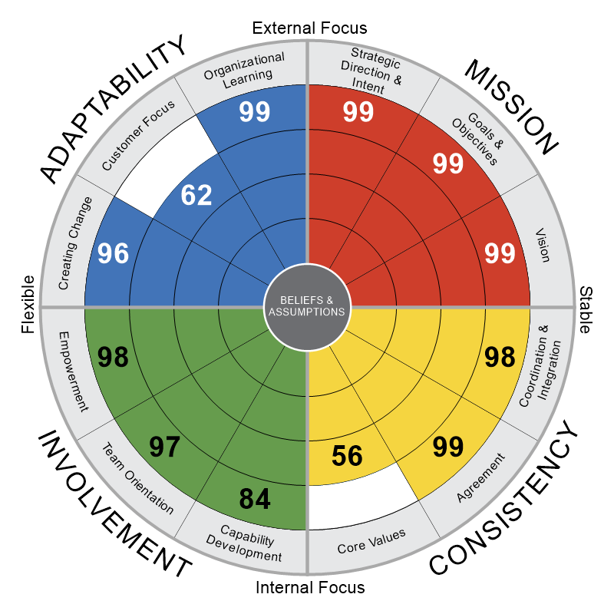
2021: Native Hawaiian or Other Pacific Islander
N = 4
NUMBERS DENOTE PERCENTILES
|
8/25/2022
|
D48NE419G-117
Authors: Daniel R. Denison, Ph.D. William S. Neale, M.A., M.L.I.R
©Daniel R. Denison, Ph.D. All rights reserved

Slide 22
Diversity & Inclusion
2021: Native Hawaiian or Other Pacific Islander
The Diversity & Inclusion module measures how effectively an organization fosters diversity (diverse representation of people) and inclusion (an inclusive and supportive work environment). The module includes four areas: (1) perceptions of inclusion and respect, (2) a workplace free of discrimination, (3) fair and equal access to opportunities, and (4) leadership commitment to diversity values.
In this organization...
PERCENTILE
0
25th
50th
75th
100th
Diversity & Inclusion
99
People with different backgrounds are treated with respect.
99
People with different backgrounds are made to feel included and like they belong.
99
Even subtle forms of discrimination are not tolerated.
99
Our recruiting and hiring practices enhance our diversity.
99
People with different backgrounds have fair and equal access to personal and professional development.
99
People with different backgrounds have fair and equal opportunities for promotion.
99
There is good support for learning about diversity.
99
We can be proud of our diversity.
88
Leaders are committed to diversity and inclusion as top priorities.
99
We do a good job of rewarding positive diversity efforts.
99
QUARTILE
1st
2nd
3rd
4th
8/25/2022 | MDI1019Q3G-120

Slide 23
Top Cultural Drivers of Diversity & Inclusion
2021: Native Hawaiian or Other Pacific Islander
We've identified cultural behaviors and values driving Diversity & Inclusion that may provide unique points of leverage for your transformation. *Improve* items are your Cultural Drivers with the most opportunity to progress. *Monitor* items may not have as much area for growth as your Improve items, but they are unique Cultural Drivers that can help prioritize actions in your transformation journey. *Sustain* items are your cultural strengths driving Diversity & Inclusion that you can leverage to drive change.
Culture Index | Cultural Drivers of Diversity & Inclusion to *Improve* | Correlation | Benchmark Percentile
Customer Focus | Customer comments and recommendations often lead to changes. | 0.99 | 1
Customer Focus | Customer input directly influences our decisions. | 0.99 | 1
Team Orientation | Teamwork is used to get work done, rather than hierarchy. | 0.99 | 66
Culture Index | Cultural Drivers of Diversity & Inclusion to *Monitor* | Correlation | Benchmark Percentile
Capability Development | The "bench strength" (capability of people) is constantly improving. | 0.99 | 76
Goals & Objectives | The leadership has clearly stated the objectives we are trying to meet. | 0.92 | 98
Customer Focus | All members have a deep understanding of customer wants and needs. | 0.92 | 97
Capability Development | Authority is delegated so that people can act on their own. | 0.85 | 94
Culture Index | Cultural Drivers of Diversity & Inclusion to *Sustain* | Correlation | Benchmark Percentile
Strategic Direction & Intent | Our strategy leads other organizations to change the way they compete in the industry. | 0.99 | 99
Organizational Learning | We make certain that everyone is informed about what is going on across the organization. | 0.99 | 99
Team Orientation | Work is organized so that each person can see the relationship between his or her job and the goals of the organization. | 0.92 | 99
Overall Diversity & Inclusion Score
You're scoring higher than 99% of the organizations in our Diversity & Inclusion Benchmark.
8/25/2022 | N = 4

Slide 24
Company Name
Organizational Culture Survey
2021: Two or more races (Not Hispanic or Latino)

Slide 25
2021: Two or more races (Not Hispanic or Latino)
N = 25
NUMBERS DENOTE PERCENTILES
|
8/25/2022
|
D48NE419G-117
Authors: Daniel R. Denison, Ph.D. William S. Neale, M.A., M.L.I.R
©Daniel R. Denison, Ph.D. All rights reserved

Slide 26
Diversity & Inclusion
2021: Two or more races (Not Hispanic or Latino)
The Diversity & Inclusion module measures how effectively an organization fosters diversity (diverse representation of people) and inclusion (an inclusive and supportive work environment). The module includes four areas: (1) perceptions of inclusion and respect, (2) a workplace free of discrimination, (3) fair and equal access to opportunities, and (4) leadership commitment to diversity values.
In this organization...
PERCENTILE
0
25th
50th
75th
100th
Diversity & Inclusion
91
People with different backgrounds are treated with respect.
65
People with different backgrounds are made to feel included and like they belong.
76
Even subtle forms of discrimination are not tolerated.
80
Our recruiting and hiring practices enhance our diversity.
89
People with different backgrounds have fair and equal access to personal and professional development.
89
People with different backgrounds have fair and equal opportunities for promotion.
82
There is good support for learning about diversity.
92
We can be proud of our diversity.
91
Leaders are committed to diversity and inclusion as top priorities.
91
We do a good job of rewarding positive diversity efforts.
88
QUARTILE
1st
2nd
3rd
4th
8/25/2022 | MDI1019Q3G-120

Slide 27
Top Cultural Drivers of Diversity & Inclusion
2021: Two or more races (Not Hispanic or Latino)
We've identified cultural behaviors and values driving Diversity & Inclusion that may provide unique points of leverage for your transformation. *Improve* items are your Cultural Drivers with the most opportunity to progress. *Monitor* items may not have as much area for growth as your Improve items, but they are unique Cultural Drivers that can help prioritize actions in your transformation journey. *Sustain* items are your cultural strengths driving Diversity & Inclusion that you can leverage to drive change.
Culture Index | Cultural Drivers of Diversity & Inclusion to *Improve* | Correlation | Benchmark Percentile
Core Values | There is an ethical code that guides our behavior and tells us right from wrong. | 0.64 | 81
Team Orientation | Cooperation across different parts of the organization is actively encouraged. | 0.58 | 94
Coordination & Integration | Our approach to doing business is very consistent and predictable. | 0.58 | 92
Culture Index | Cultural Drivers of Diversity & Inclusion to *Monitor* | Correlation | Benchmark Percentile
Vision | Our vision creates excitement and motivation for our employees. | 0.67 | 95
Goals & Objectives | We continuously track our progress against our stated goals. | 0.62 | 95
Culture Index | Cultural Drivers of Diversity & Inclusion to *Sustain* | Correlation | Benchmark Percentile
Creating Change | New and improved ways to do work are continually adopted. | 0.67 | 98
Coordination & Integration | It is easy to coordinate projects across different parts of the organization. | 0.66 | 97
Goals & Objectives | The leadership has clearly stated the objectives we are trying to meet. | 0.62 | 98
Coordination & Integration | People from different parts of the organization share a common perspective. | 0.62 | 97
Team Orientation | People work like they are part of a team. | 0.62 | 97
Overall Diversity & Inclusion Score
You're scoring higher than 91% of the organizations in our Diversity & Inclusion Benchmark.
8/25/2022 | N = 25

