Slide 1


Merger & Acquisition Text Analysis
“Share 3 adjectives that you feel should describe the culture of our integrated company between Organization 1 and Organization 2.”
Research & Development

Slide 2
Overview
Top adjectives defining an ideal integrated culture
Cross Comparisons
Adjectives for culture frequently used together
Appendix

Slide 3
Top adjectives defining an ideal integrated culture

Slide 4
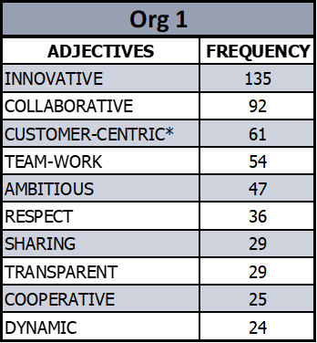
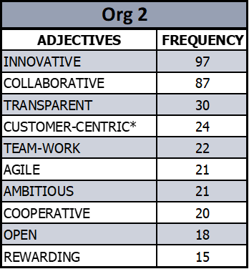
Top 10 – Combined, Org 1, and Org 2
*Other variants of “customer-centric” include “–oriented”, “-driven”, “-focused”, “satisfaction”

Slide 5
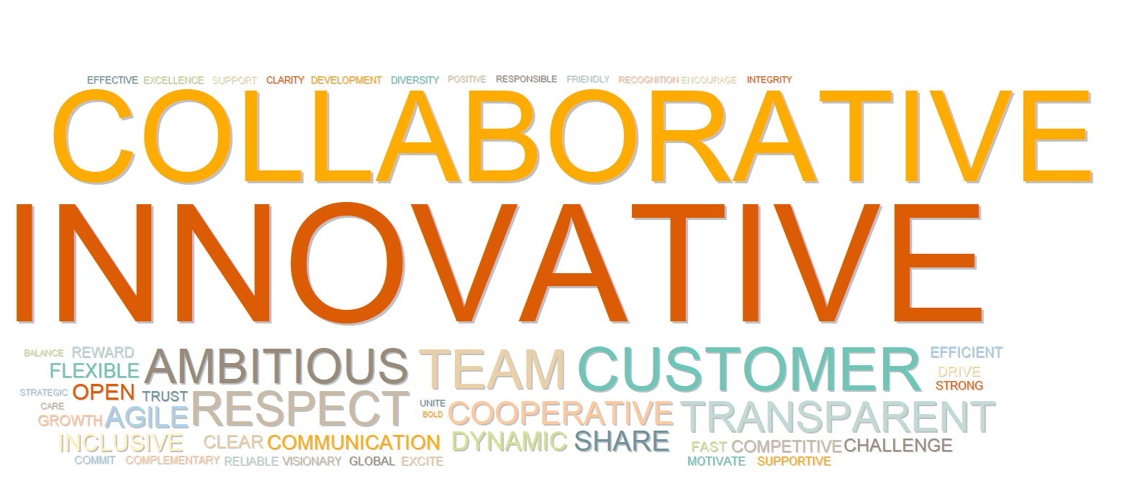
Combined Word Cloud – All Words

Slide 6
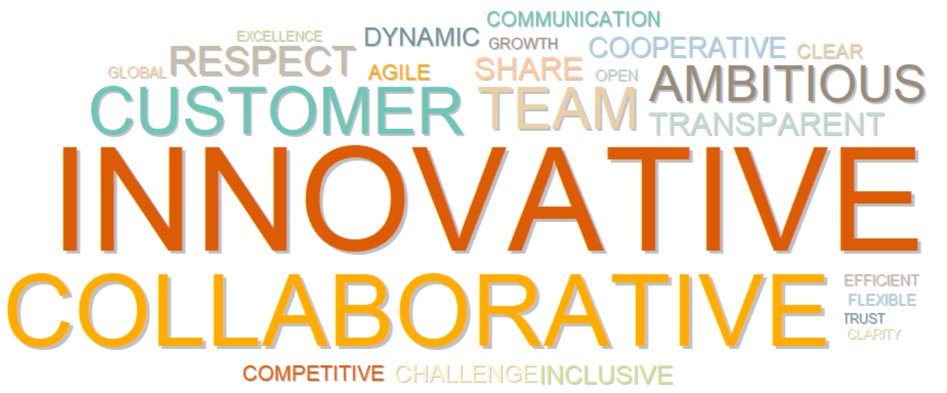
Org 1 Word Cloud – All Words

Slide 7

Org 2 Word Cloud – All Words

Slide 8
Cross Comparisons
Insights from this section are derived from charts shown in the Appendix.

Slide 9
Key Insights
Org 1 respondents showed a stronger focus on a culture that is respectful, inclusive, and diverse
      “Respectful” was used 3.6 times more often by Org 1 respondents (“Inclusive” 1.37 times more; “Diversity” 1.48 times more)
Org 1 respondents showed a prioritization of clarity and communication
      “Clarity” was used 8 times more often by Org 1 respondents (“Clear” 1.38 times more; “Communication” 1.35 times more)
Org 1 respondents highlighted a prioritization of team-work & sharing
      “Team-work” was used 1.61 times more and “Sharing” was used 1.9 times more by Org 1 respondents
Org 2 respondents showed a stronger focus on openness & transparency
      “Open” was used 2 times more by Org 2 respondents and “Transparency” was used 1.58 times more
Both organizations showed a prioritization of market competitiveness, but respondents used distinct adjectives to describe that culture
      Org 1 respondents used “Global”, “Growth”, “Competitive”, and “Ambitious” more often
      Org 2 respondents used “Strong”, “Driven”, “Fast”, “Exciting”, “Agile”, and “Flexible” more often

Slide 10
Adjectives for culture frequently used together
Adjectives in green are those that are not in the Top 10 but were listed most frequently with Top 10 adjective – those in white are other Top 10 adjectives.

Slide 11
Innovative & Collaborative
Respondents who mentioned a culture of innovation also mentioned a dynamic, inclusive, rewarding, competitive, and challenging culture.
Respondents who mentioned a collaborative culture also mentioned inclusion, clarity, and flexibility.
*Other variants of “customer-centric” include “–oriented”, “-driven”, “-focused”, “satisfaction.”
In these tables, “FREQUENCY” refers to the number of times a given word was listed alongside the Top 10 adjective in the title.

Slide 12
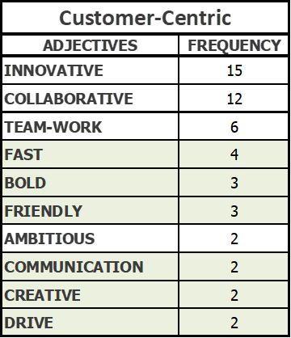
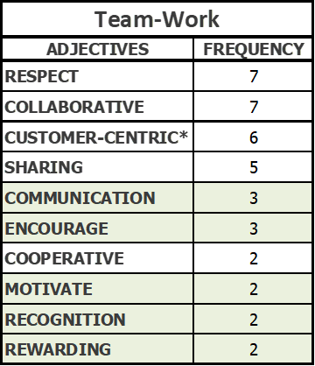
Customer-Centric & Team-Work
Respondents who described a customer-centric culture also mentioned a culture that is fast, bold, friendly, creative, and driven.
Respondents who described a culture of team-work also mentioned communication and encouragement as well as a culture of motivation, recognition, and rewarding.
*Other variants of “customer-centric” include “–oriented”, “-driven”, “-focused”, “satisfaction.”
In these tables, “FREQUENCY” refers to the number of times a given word was listed alongside the Top 10 adjective in the title.

Slide 13
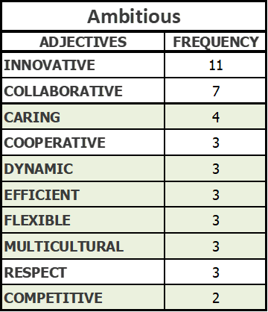
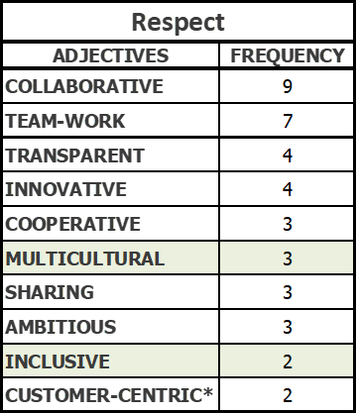
Ambitious & Respect
Respondents who described an ambitious culture also mentioned a culture that is caring, dynamic, efficient, flexible, multicultural, and competitive in the market.
Respondents who described a culture of respect also mentioned multiculturalism and inclusivity.
*Other variants of “customer-centric” include “–oriented”, “-driven”, “-focused”, “satisfaction.”
In these tables, “FREQUENCY” refers to the number of times a given word was listed alongside the Top 10 adjective in the title.

Slide 14
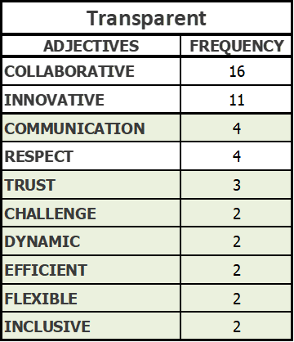
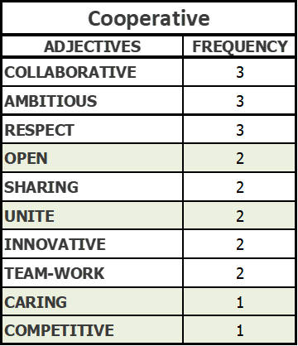
Transparent & Cooperative
Respondents who described a transparent culture also mentioned communication, trust, a desire for challenge, as well as a culture that is dynamic, efficient, flexible, and inclusive.
Respondents who described a cooperative culture also mentioned openness, unity, caring, and competitiveness in the market.
In these tables, “FREQUENCY” refers to the number of times a given word was listed alongside the Top 10 adjective in the title.

Slide 15
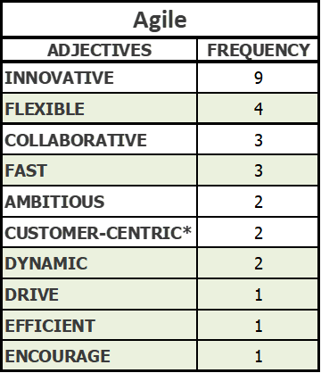
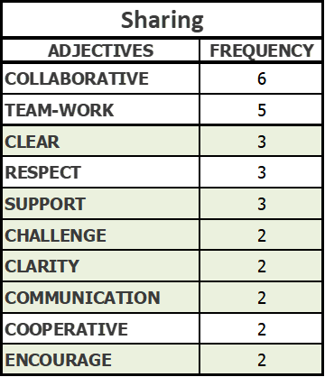
Agile & Sharing
Respondents who described an agile culture also mentioned culture that is flexible, fast, dynamic, driven, efficient, and encouraging.
Respondents who described a culture of sharing also mentioned a focus on clear communication and a culture that is marked by supporting, challenging, clarity, and encouragement.
*Other variants of “customer-centric” include “–oriented”, “-driven”, “-focused”, “satisfaction.”
In these tables, “FREQUENCY” refers to the number of times a given word was listed alongside the Top 10 adjective in the title.

Slide 16
Appendix

Slide 17
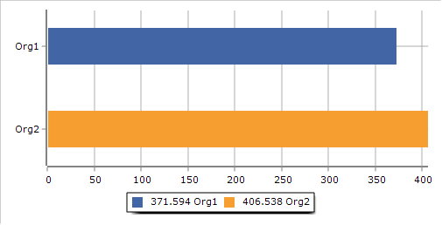
Innovative
** Cross-Comparisons use a standard measure of ‘Rate per 10,000 words’, which allows us to compare data across groups in the data while controlling for differences in the size of those groups.

Slide 18
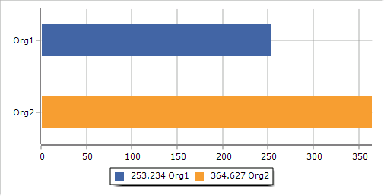
Collaborative
** Cross-Comparisons use a standard measure of ‘Rate per 10,000 words’, which allows us to compare data across groups in the data while controlling for differences in the size of those groups.

Slide 19
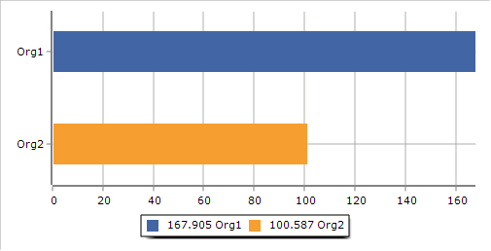
Customer-Centric
** Cross-Comparisons use a standard measure of ‘Rate per 10,000 words’, which allows us to compare data across groups in the data while controlling for differences in the size of those groups.

Slide 20

Team-Work
** Cross-Comparisons use a standard measure of ‘Rate per 10,000 words’, which allows us to compare data across groups in the data while controlling for differences in the size of those groups.

Slide 21
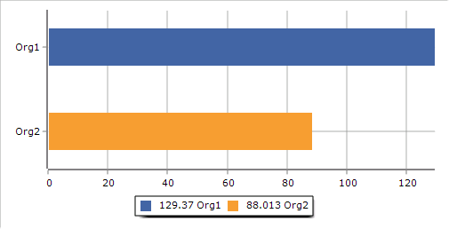
Ambitious
** Cross-Comparisons use a standard measure of ‘Rate per 10,000 words’, which allows us to compare data across groups in the data while controlling for differences in the size of those groups.

Slide 22
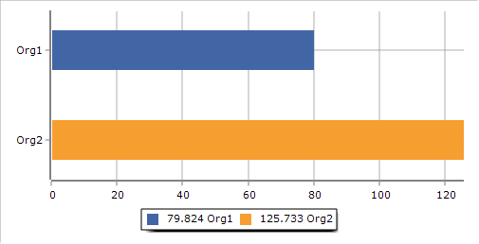
Transparent
** Cross-Comparisons use a standard measure of ‘Rate per 10,000 words’, which allows us to compare data across groups in the data while controlling for differences in the size of those groups.

Slide 23
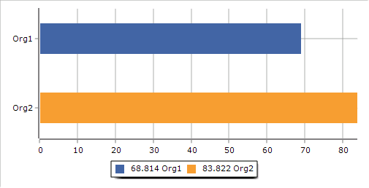
Cooperative
** Cross-Comparisons use a standard measure of ‘Rate per 10,000 words’, which allows us to compare data across groups in the data while controlling for differences in the size of those groups.

Slide 24
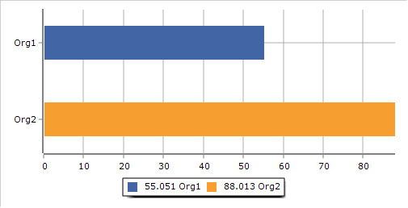
Agile
** Cross-Comparisons use a standard measure of ‘Rate per 10,000 words’, which allows us to compare data across groups in the data while controlling for differences in the size of those groups.

Slide 25
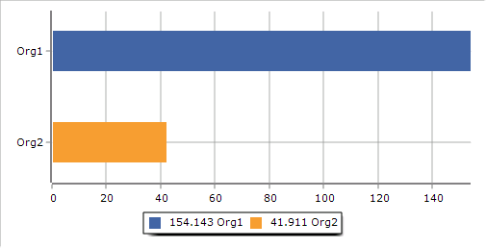
Respect
** Cross-Comparisons use a standard measure of ‘Rate per 10,000 words’, which allows us to compare data across groups in the data while controlling for differences in the size of those groups.

Slide 26
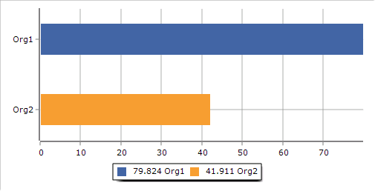
Sharing
** Cross-Comparisons use a standard measure of ‘Rate per 10,000 words’, which allows us to compare data across groups in the data while controlling for differences in the size of those groups.

